Slide 1
Thurgood Marshall MS
Yosemite Adventure
March 26th - 30th 2023

Slide 2
Who is...

Slide 3
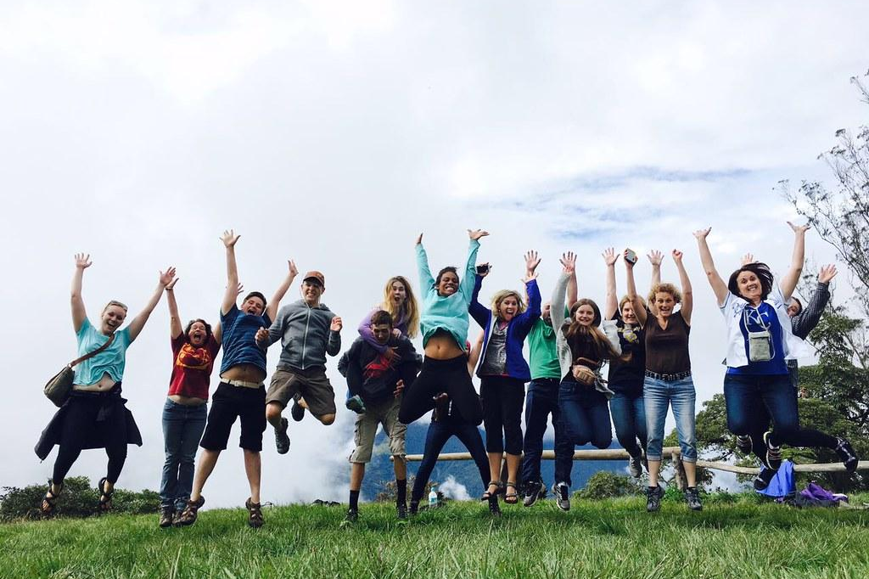
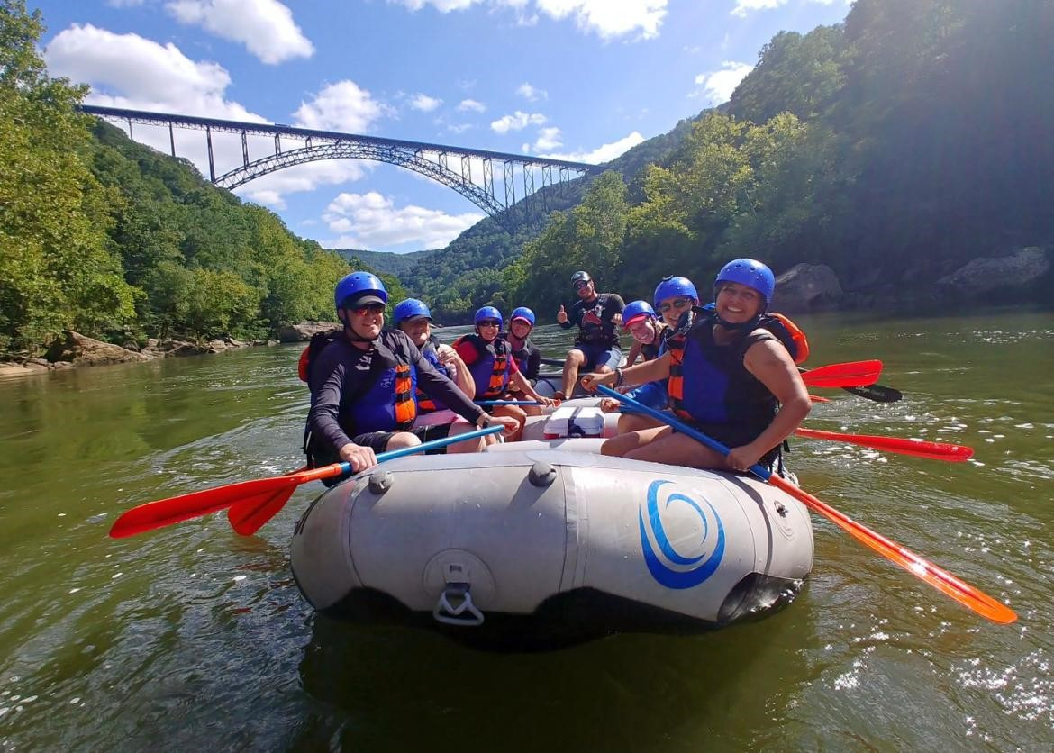
Grand Classroom is a student travel company that specializes in taking young people on educational trips around the world.
Grand Classroom began with trips to our National Parks in 2002 and has grown to include historic U.S. cities and international destinations. Our programs span from Washington, D.C. and New York to the Grand Canyon, Yellowstone, Florida, Puerto Rico, the Pacific Northwest, Galapagos, Belize, Iceland, Costa Rica, and more!

Slide 4
Safety is our main concern...
24 Hour Grand Classroom guides
24 hour emergency contact number
On-call telemedicine
Medical and dental insurance while on tour
Liability insurance

Slide 5
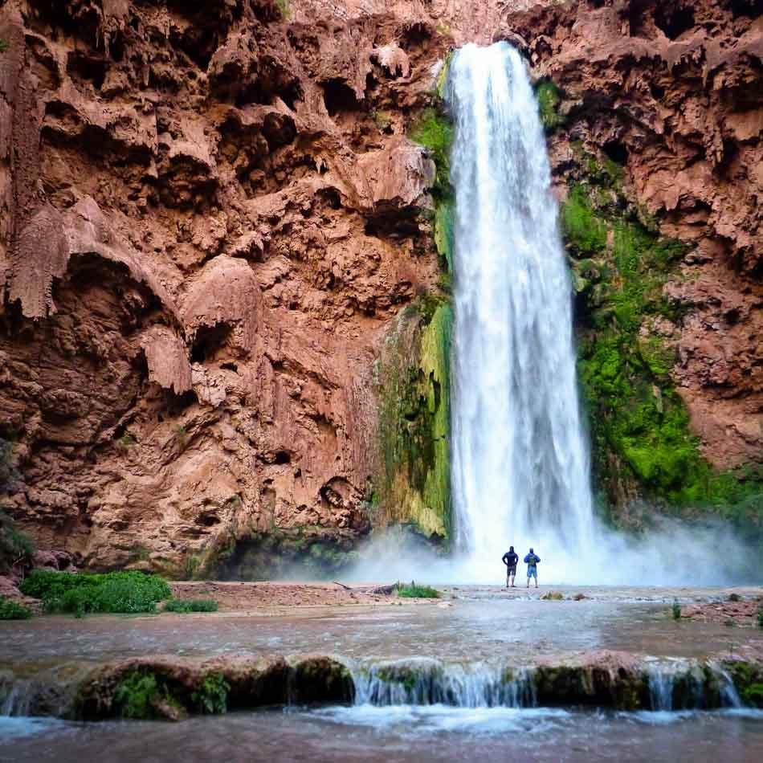
Student Health on Tour
Parents will notify Grand Classroom of any medical conditions or dietary concerns prior to travel.
Grand Classroom will work directly with our vendors to accommodate dietary restrictions.
Teachers hold on to and administer any student medication while on tour.

Slide 6
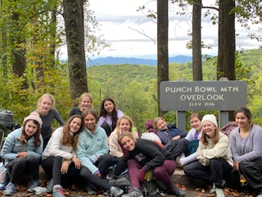
Benefits of Student Travel
Builds confidence
Encourages leadership
Harvests friendships
Provides education outside the classroom
Teaches team building
Instills independence
Provides adventure
Bestows stewardship towards the environment

Slide 7
Trip Highlights

Slide 8
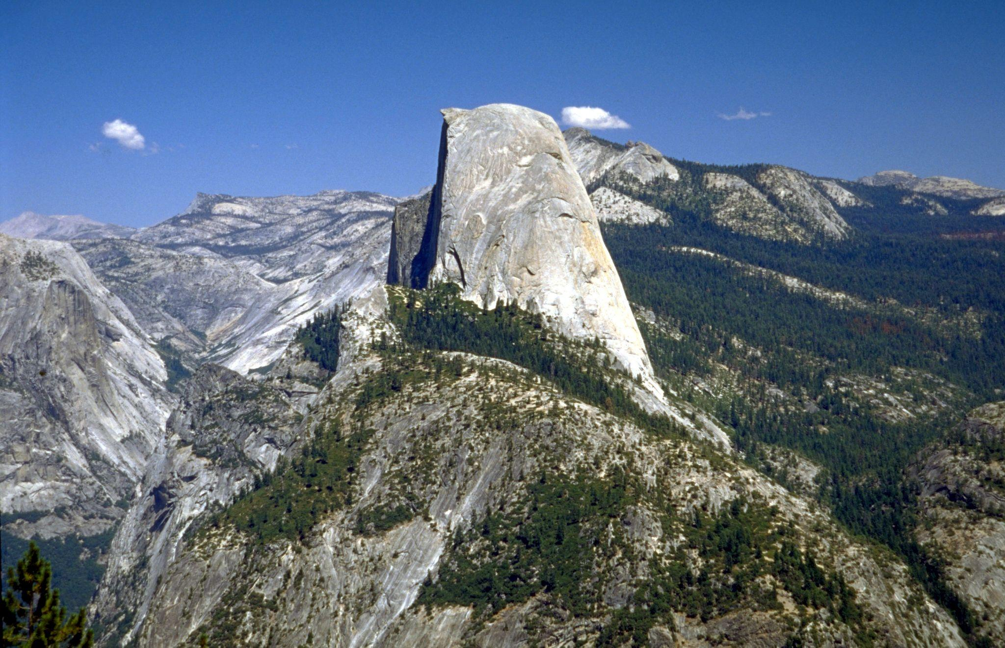
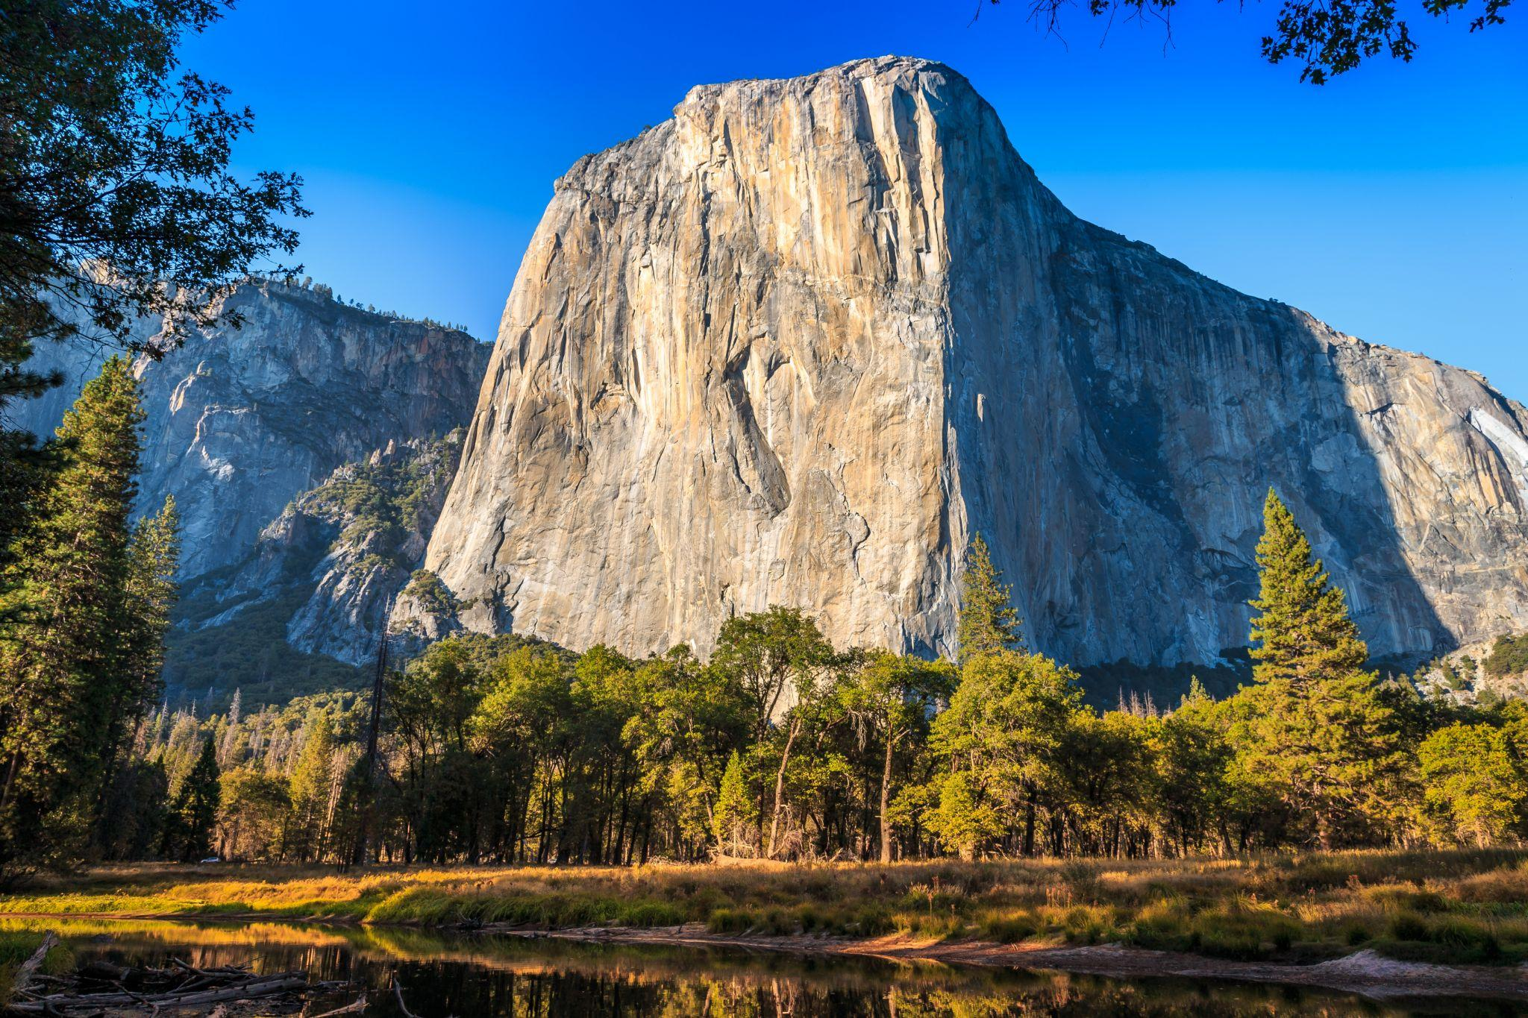
Stand at the base of El Capitan & Half Dome
Hike the Mist Trail to Vernal & Nevada Falls
Stay in Curry Village and explore Yosemite Village

Slide 9
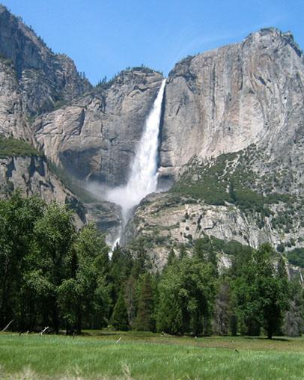
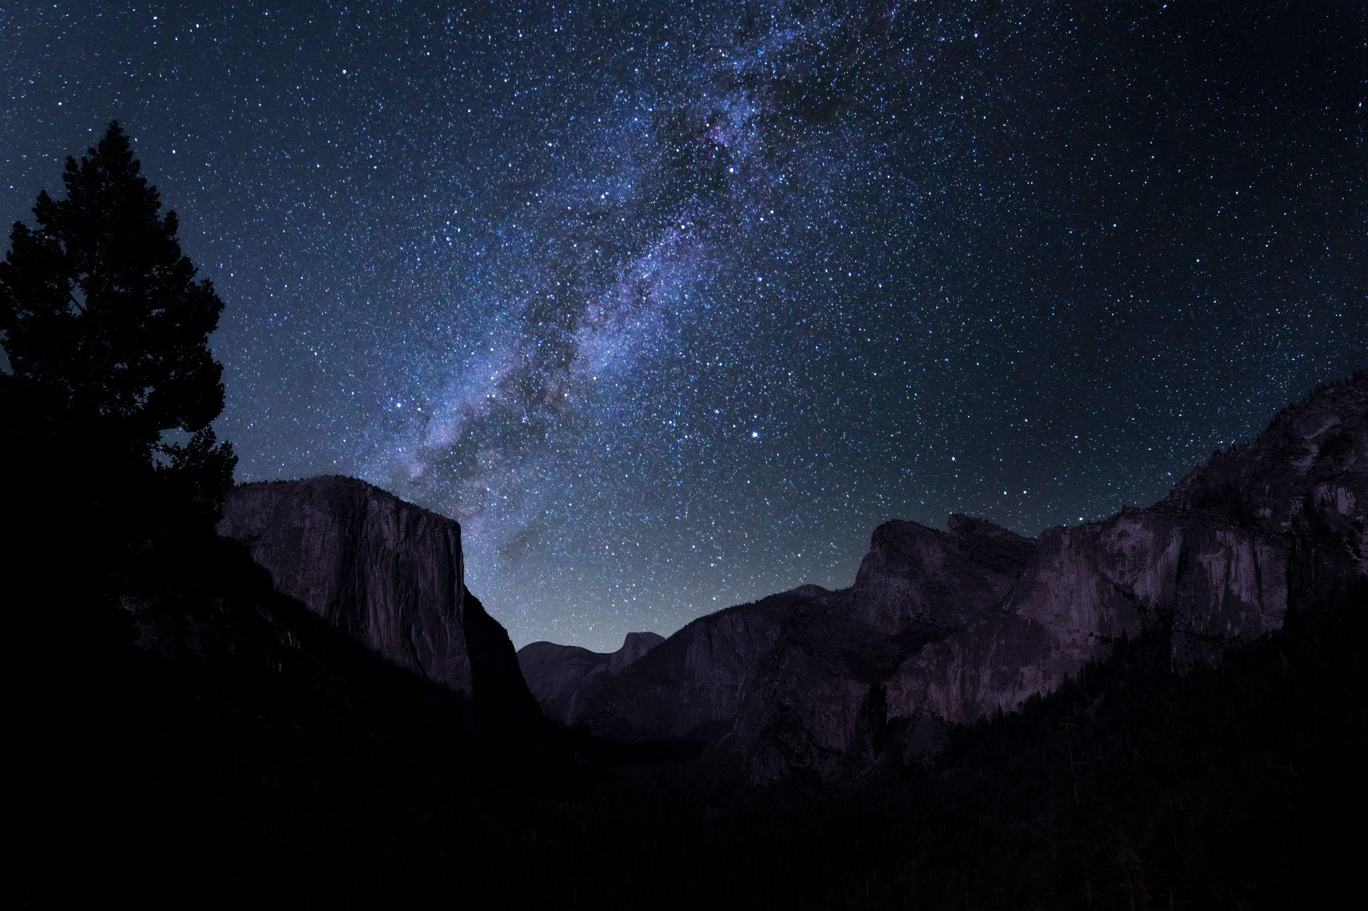
Hike to Tuolumne Grove of Giant Sequoias
Discover the Night Skies Over Yosemite
Visit the Ansel Adams Art Gallery

Slide 10
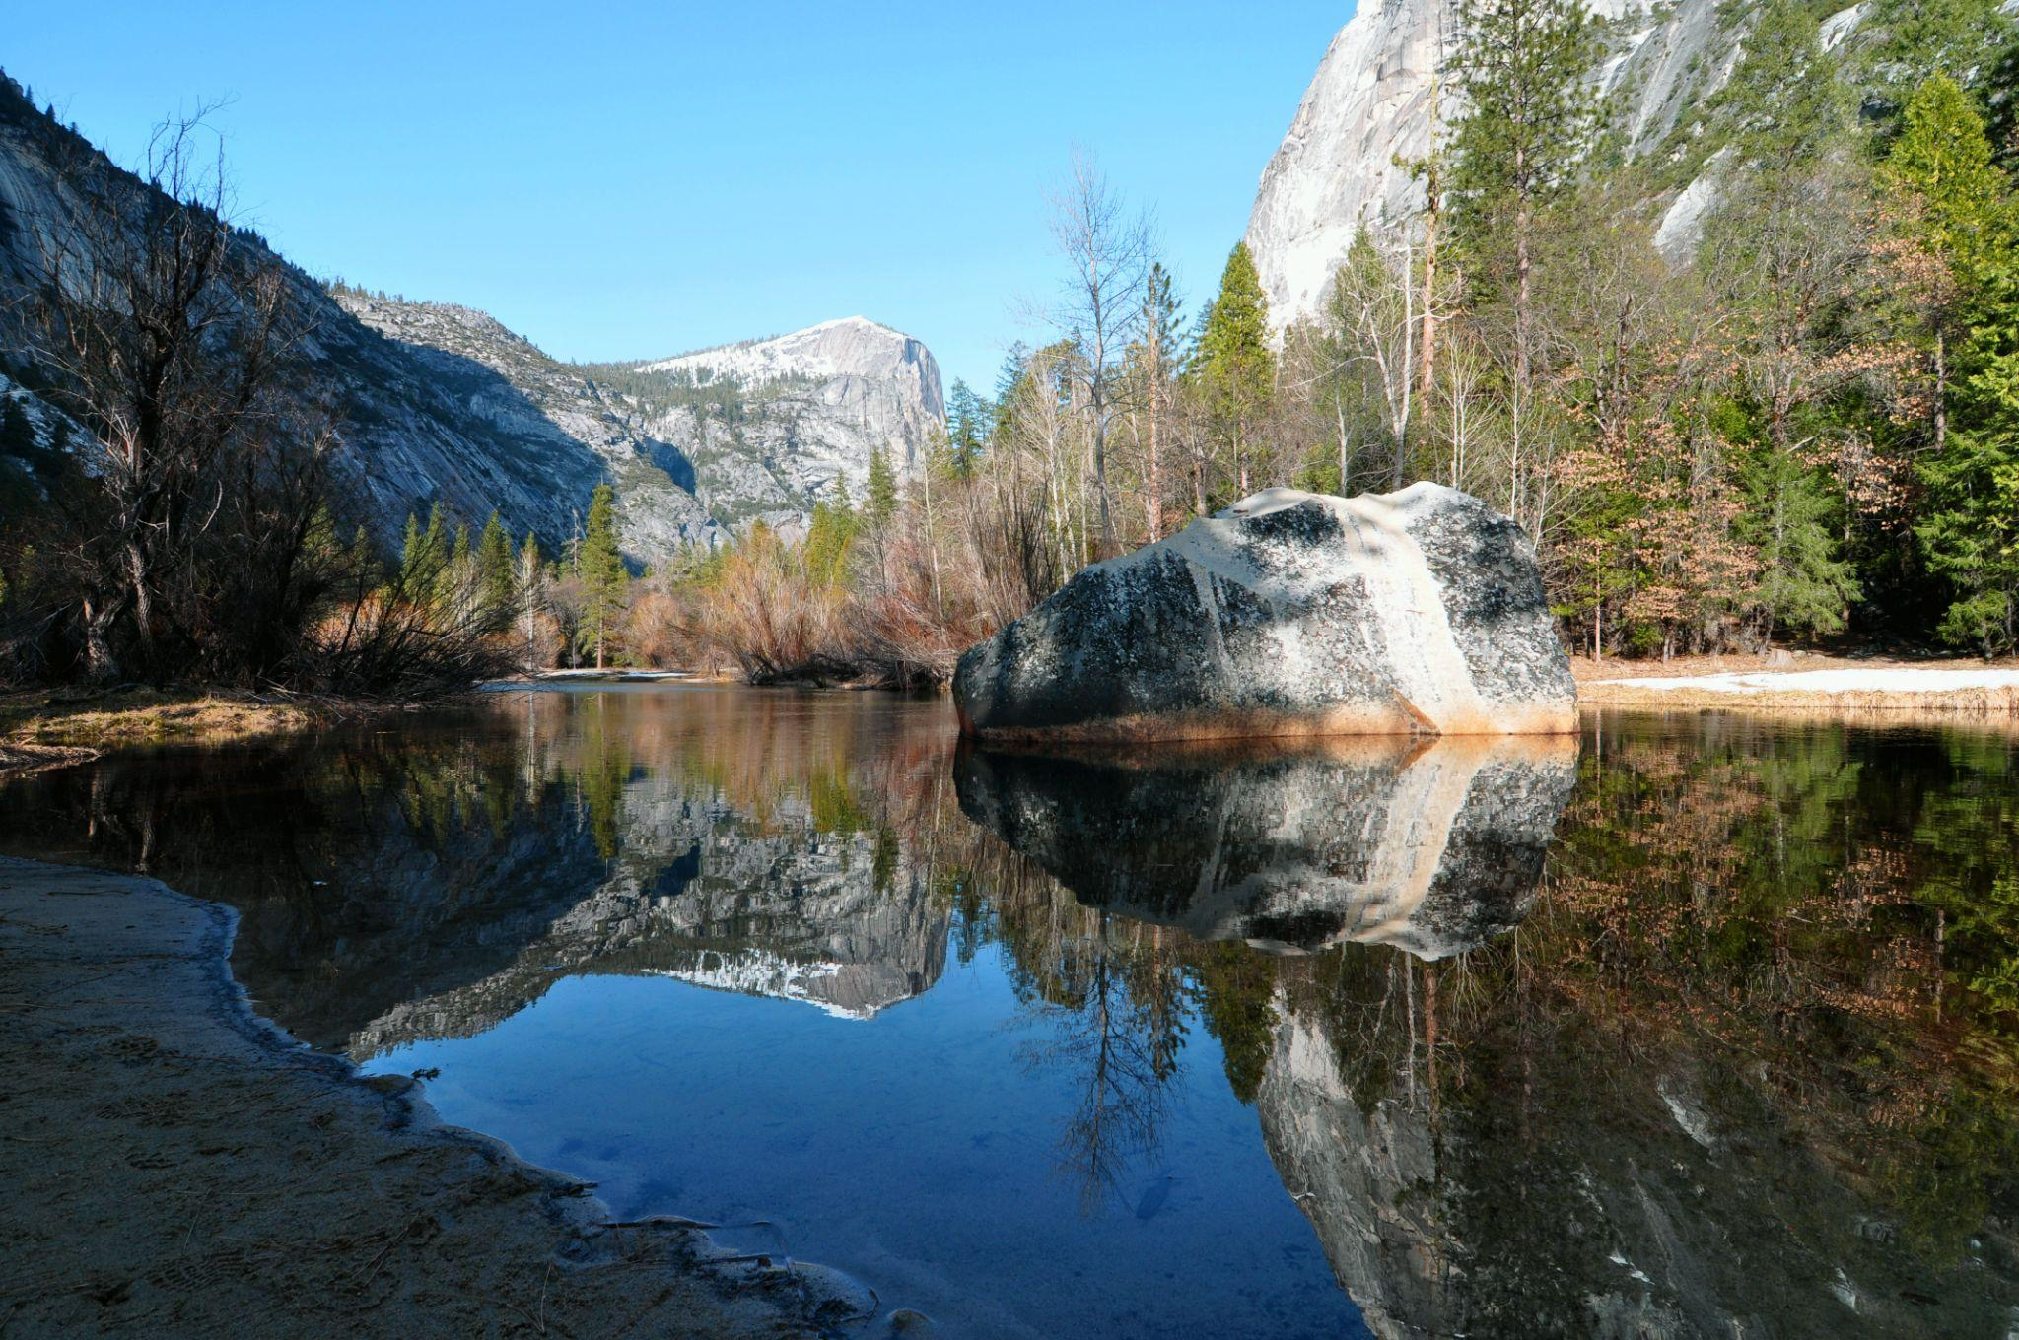
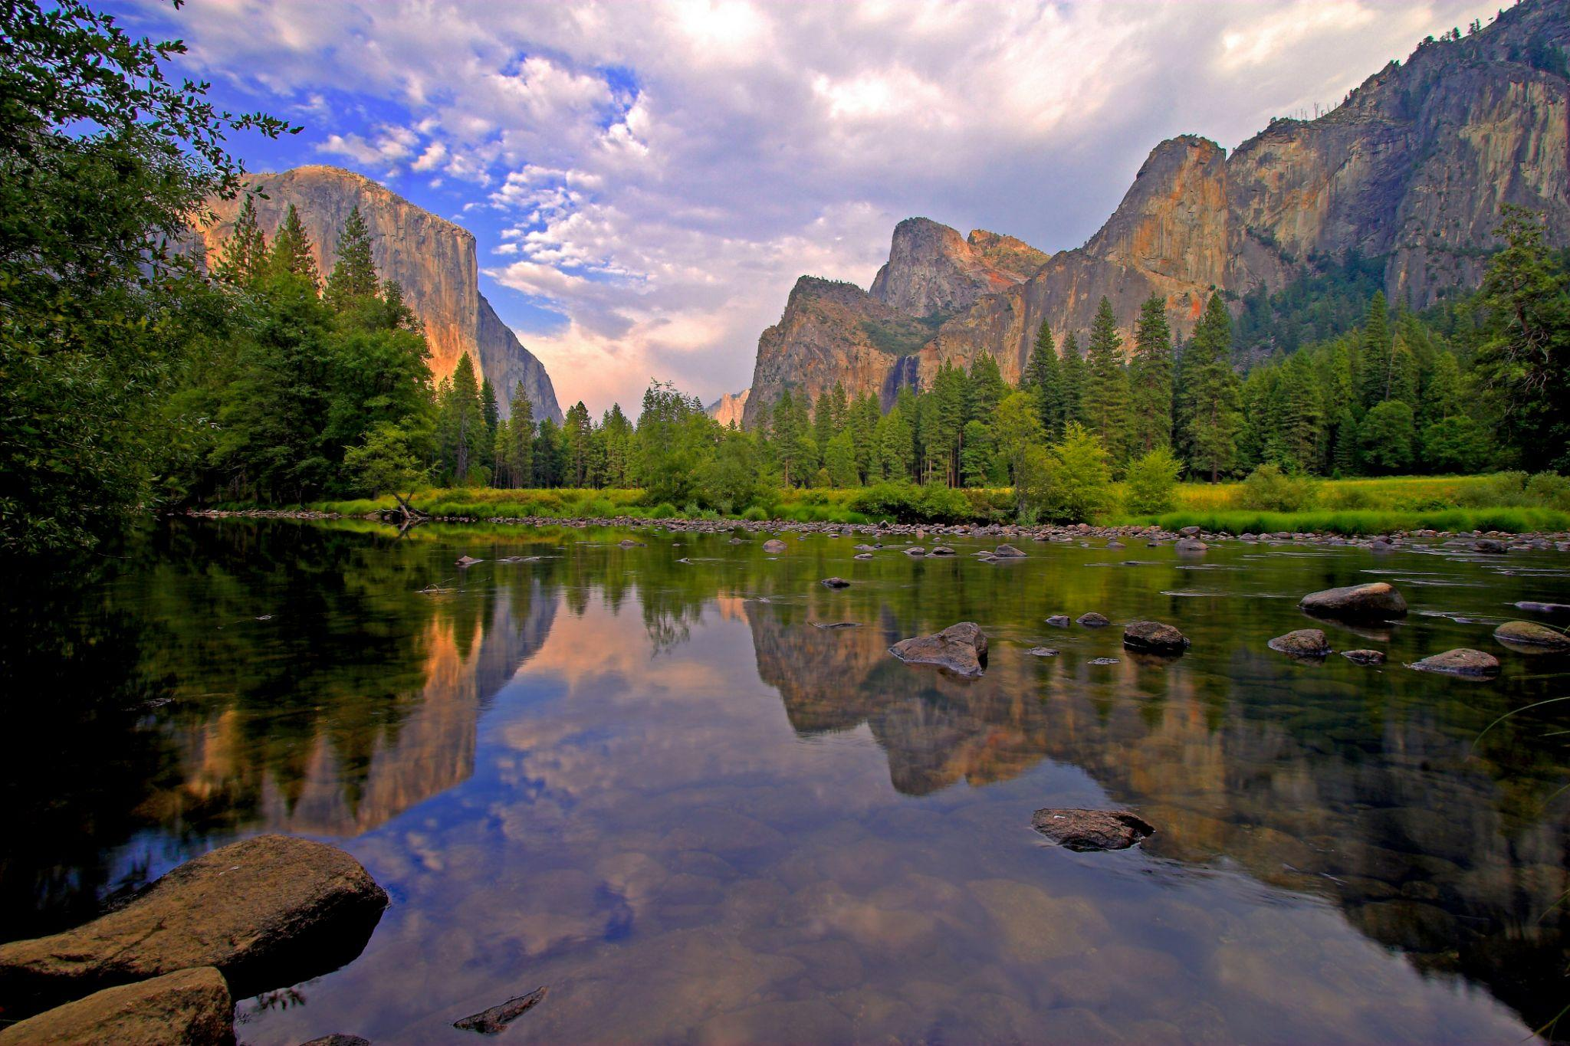
View the Valley from Glacier Point & hike the 4 mile trail back down, taking in the incredible views
Enjoy the tranquility of the High Sierras in Yosemite Valley
Visit Bridal Veil Falls

Slide 11
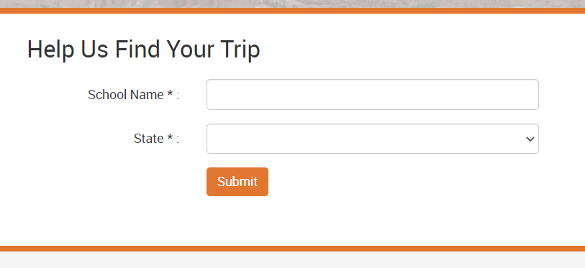
How to Register
Visit www.grandclassroom.com and search for your trip by entering your school name and state.
$1,674 per student
$167 deposit due at registration
Optional payment plans available at registration.
Trip Protection Options
Travel Refund Program Plus: $318
(includes cancellations due to COVID 19)
Travel Refund Program: $150
Limited Refund Policy: (included)
See Terms and Conditions for more information.

Slide 12
FAQs
What does the trip cost include? It is an all-inclusive price that covers motor coach, tour guide, lodging, all meals while on tour, activity admissions, medical/dental coverage, and trip planning.
How much spending money should I bring? We recommend about $50-$100 for snacks, souvenirs and an optional tip for your Grand Classroom guide.
What is the rooming situation? Students stay 4 to a cabin tent. Teachers will assign rooms.
Curry Village Cabin Tents
What forms do I need to fill out? You will be sent a medical form and a behavior contract through the Grand Classroom trip page closer to travel. This is where you will note any dietary restrictions or allergies.

Slide 13
Questions?
Contact your Grand Classroom representative,
Paul Lupini
Email: paul@grandclassroom.com
Phone: 434-975-2629

Slide 14
See you in the great outdoors!

