Slide 1
International School of Indiana
New York City Adventure
May 22nd - 26th 2023

Slide 2
Who is...

Slide 3
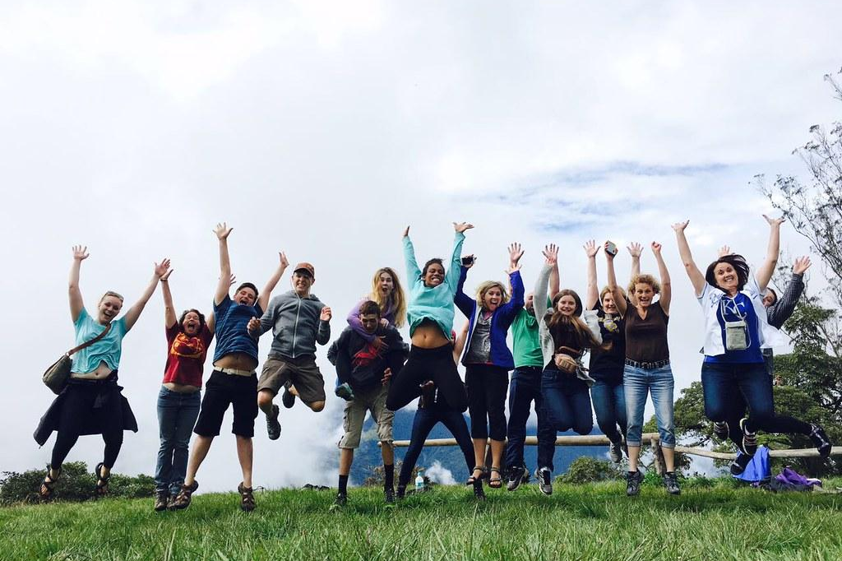
Grand Classroom is a student travel company that specializes in taking young people on educational trips around the world.
Grand Classroom began with trips to our National Parks in 2002 and has grown to include historic U.S. cities and international destinations. Our programs span from Washington, D.C. and New York to the Grand Canyon, Yellowstone, Florida, Puerto Rico, the Pacific Northwest, Galapagos, Belize, Iceland, Costa Rica, and more!

Slide 4
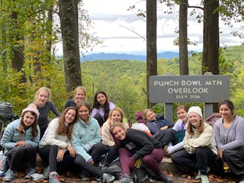
Benefits of Student Travel
*Builds confidence and independence
*Encourages leadership and team building
*Harvests friendships
*Provides education outside the classroom
*Provides adventure

Slide 5
Safety is our main concern...
*24 Hour Grand Classroom guides
*24 hour emergency contact number
*On-call nurse practitioner
*Medical and dental insurance while on tour
*Liability insurance
*Security at hotels

Slide 6
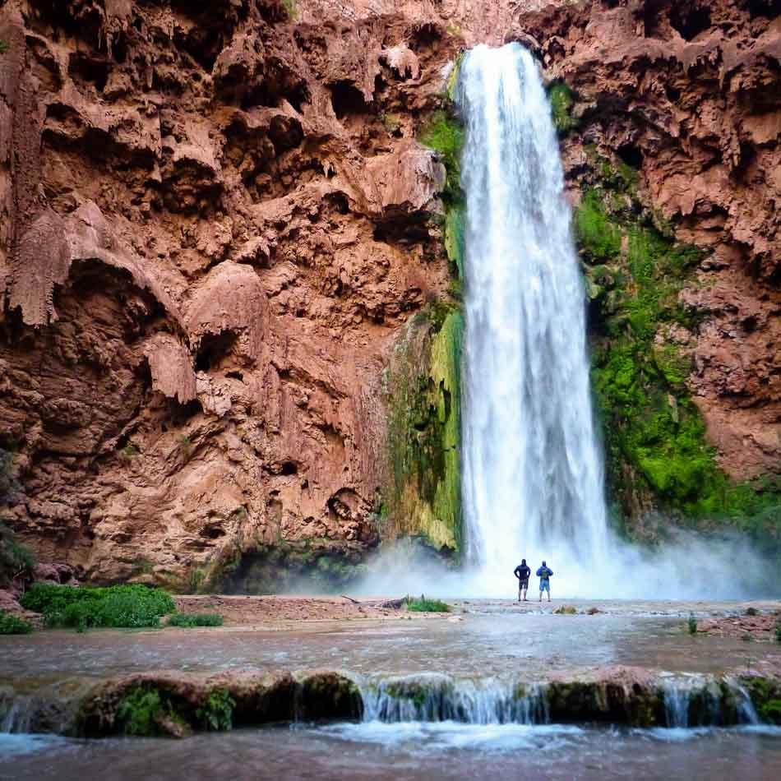
Student Health on Tour
*Grand Classroom will take note of all medical conditions and dietary concerns before the trip
*Students hold on to and administer any student medication while on tour
*Notify Grand Classroom of any food allergies and we will work directly with our vendors to accommodate.

Slide 7
All Inclusive Trip!
Transportation and Hotels
Meals
24 Hour Guides with your group!
Educational and Adventure Activities
Medical Insurance
Entrance Fees
*The only thing you will need money for is souvenirs!*

Slide 8
Trip Highlights

Slide 9
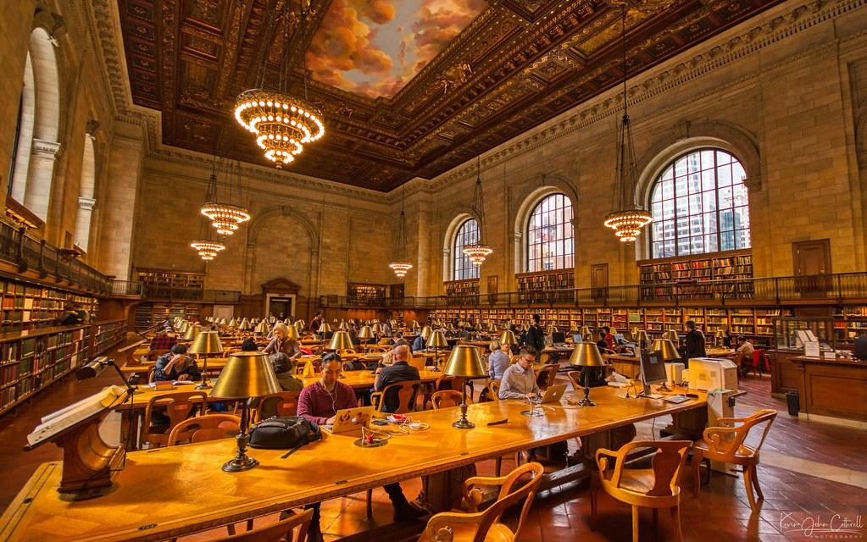
Visit the Rose Main Reading Room and Bryant Park
Explore Central Park on a walk to the Upper East Side
Take the Metro to Gotham Market
Explore Times Square

Slide 10
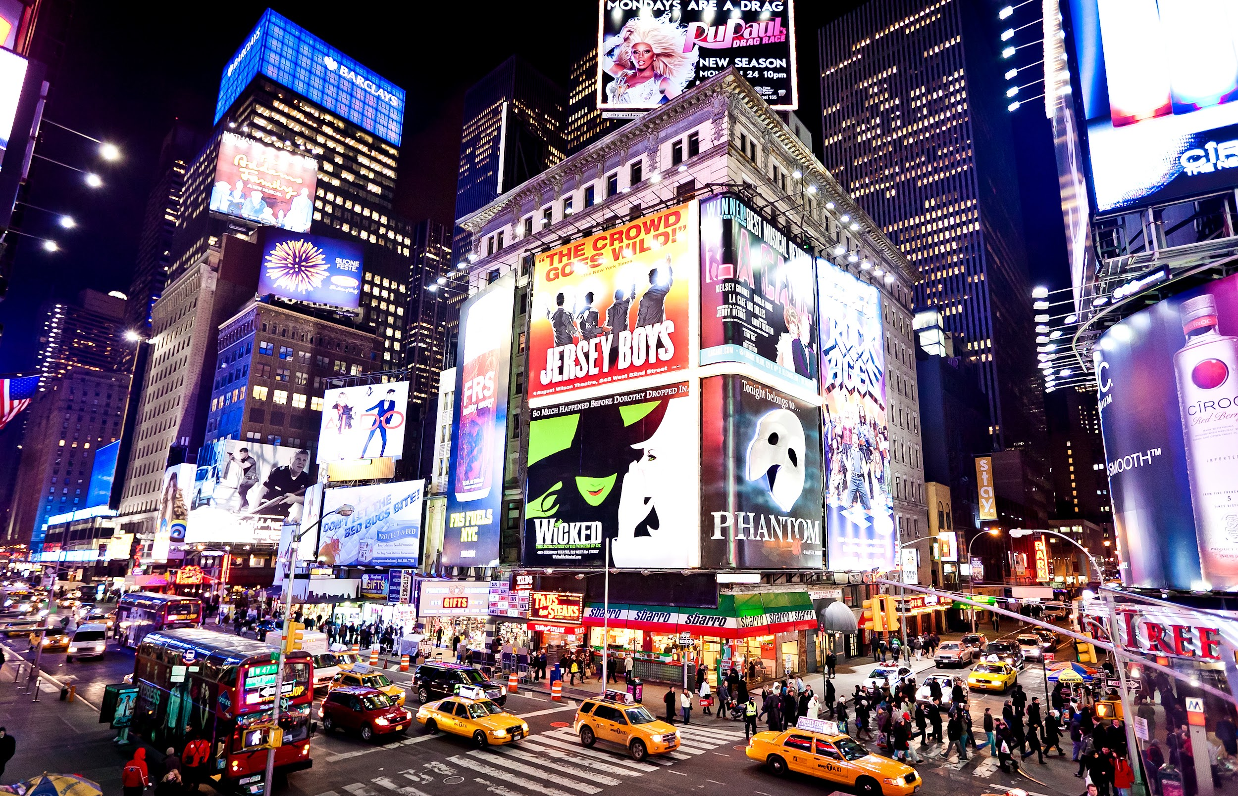
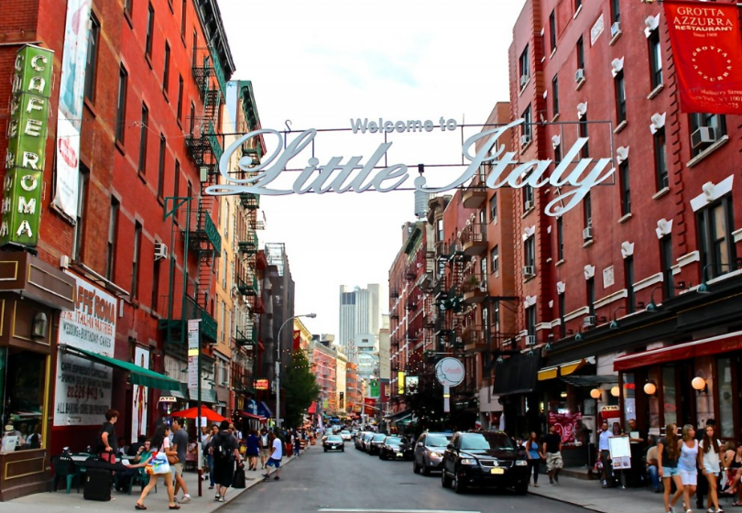
Visit the 9/11 Memorial
Explore Little Italy, Chinatown and the Village
Walk the Highline
See & Juliet on Broadway

Slide 11
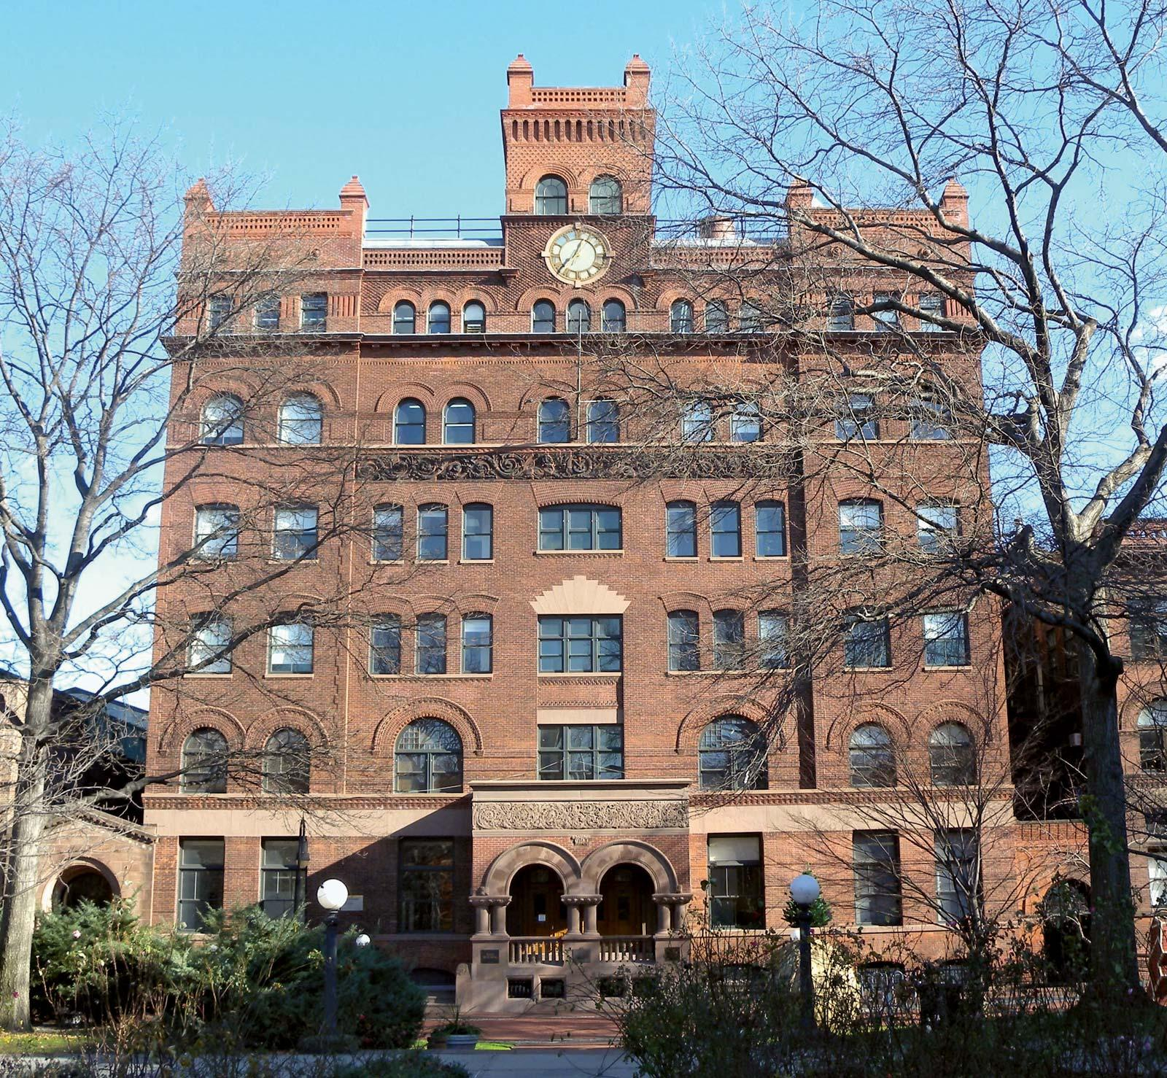
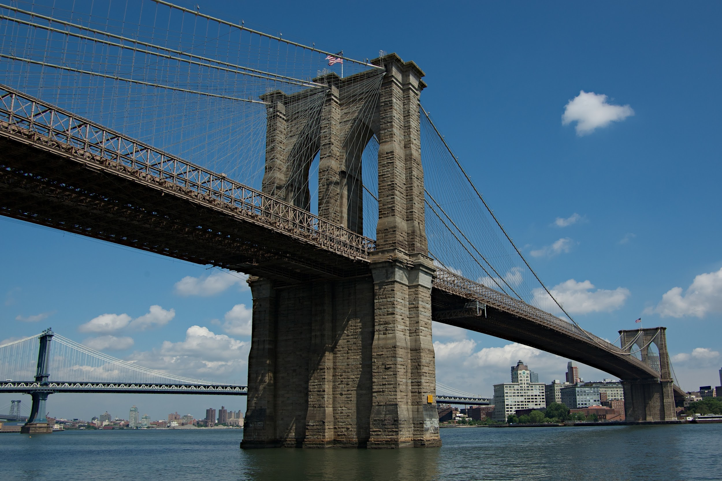
Visit Carnegie Hall
Walk across the Brooklyn Bridge
Visit the Pratt Institute
Enjoy a performance of Life of Pi on Broadway

Slide 12
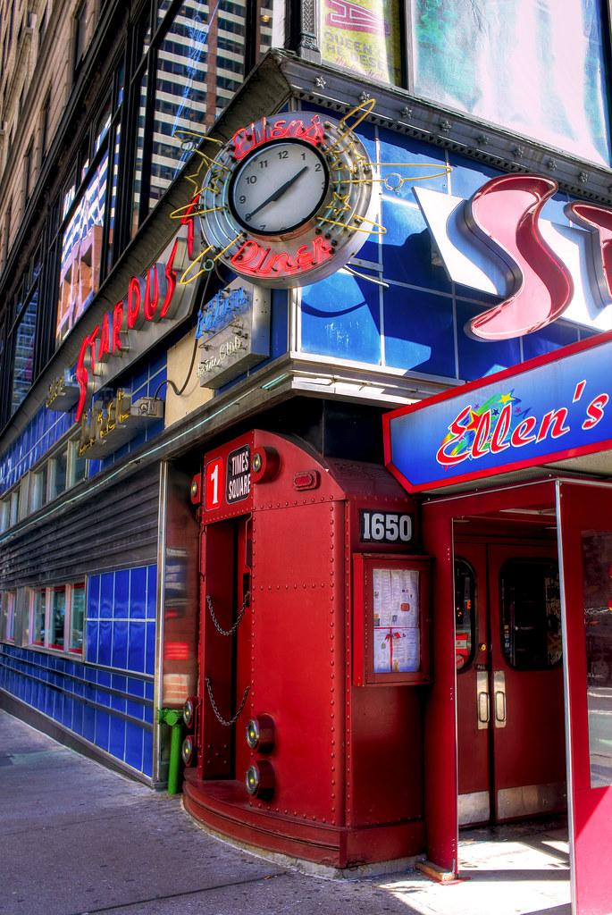
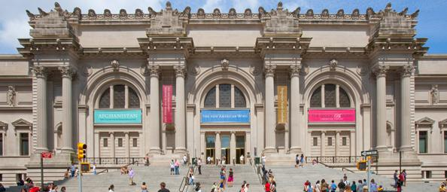
Visit the Metropolitan Museum of Art
Visit the The Julliard School
Explore the Museum of Modern Art
Enjoy Dinner at Ellen’s Stardust Diner
See Mozart’s Die Zauberflote (The Magic Flute) at the Metropolitan Opera

Slide 13
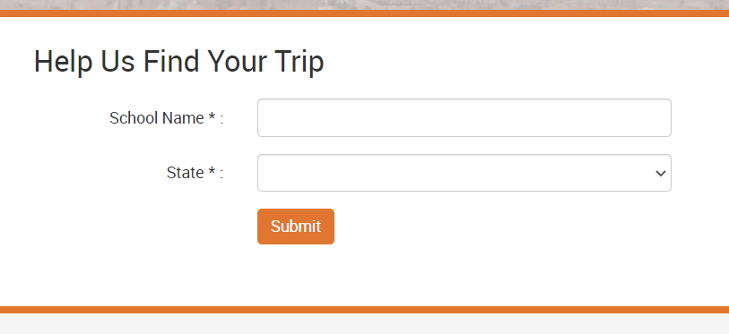
How to Register
Visit www.grandclassroom.com and search for your trip by entering your school name and state.
$2,300 per student
$150 deposit due at registration
Optional payment plans available at registration.
Trip Protection Options
Travel Refund Program Plus: $325
(includes cancellations due to COVID 19)
Travel Refund Program: $185
Limited Refund Policy: (included)
See Terms and Conditions for more information.

Slide 14
FAQs
What does the trip cost include? It is an all-inclusive price that covers airfare, transfer bus to/from airport in NYC, tour guide, lodging, all meals while on tour, activity admissions, medical/dental coverage, and trip planning.
How much spending money should I bring? We recommend about $50-$100 for snacks and souvenirs
What is the rooming situation? Students stay 4 to a room. Teachers will assign rooms.
What forms do I need to fill out? You will be sent a medical form and a behavior contract through the Grand Classroom trip page closer to travel. This is where you will note any dietary restrictions or allergies.

Slide 15
Questions?
Contact your Grand Classroom representative,
Emily Forrest
Email: emily@grandclassroom.com
Phone: 434-975-2629

Slide 16
See you in NYC!

