Slide 1
Carrollwood Day School
Boston Adventure April 9-12, 2024

Slide 2
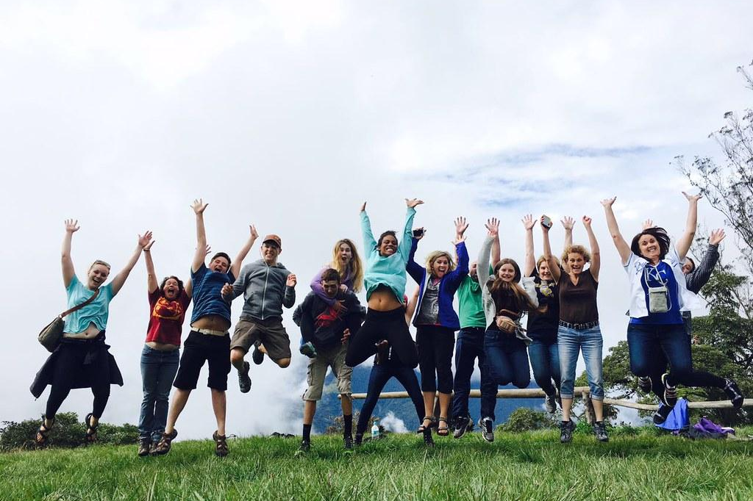
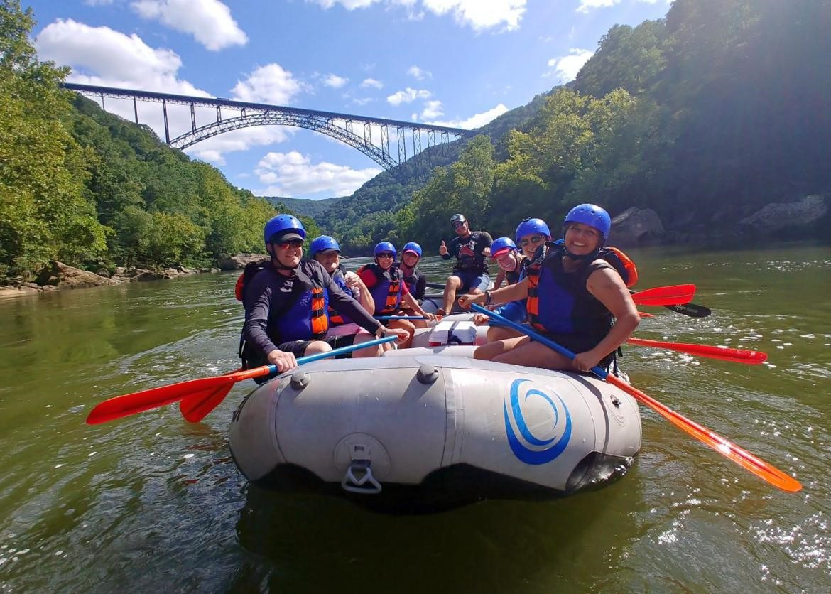
Grand Classroom is a travel company that specializes in taking people on educational trips around the world.
Grand Classroom began with trips to our National Parks in 2002 and has grown to include historic U.S. cities and international destinations. Our programs span from Washington, D.C. and New York to the Grand Canyon, Yellowstone, Florida, Puerto Rico, the Pacific Northwest, Galapagos, Belize, Iceland, Costa Rica, and more!

Slide 3
Safety is our main concern...
24 Hour Grand Classroom guides
24 hour emergency contact number
Medical and dental insurance while on tour
Liability insurance
Evening security at hotels

Slide 4
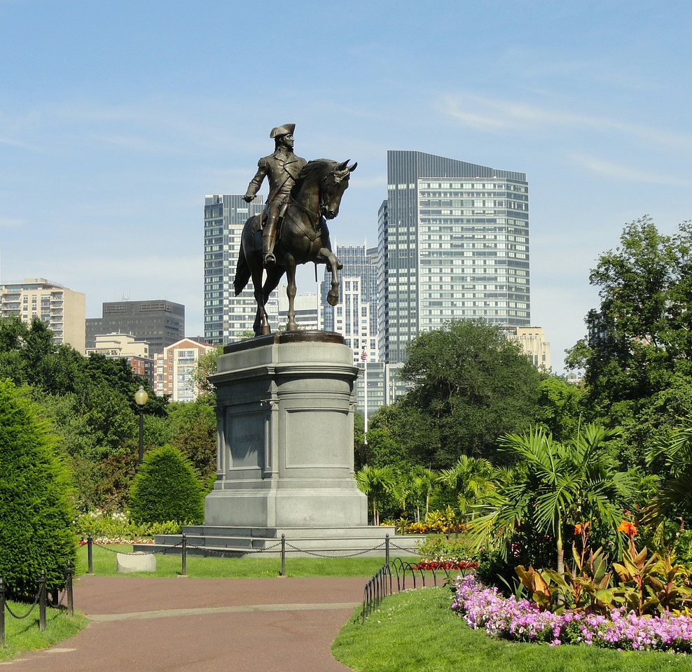
Traveler Health on Tour
Travelers will notify Grand Classroom of any medical conditions or dietary concerns prior to travel.
Grand Classroom will work directly with our vendors to accommodate dietary restrictions.
Teachers hold on to and administer any medications while on tour. Exceptions for those who self carry epipens and inhalers.

Slide 5
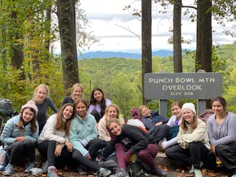
Benefits of Student Travel
Builds confidence
Instills independence & encourages leadership
Harvests friendships
Provides education outside the classroom
Teaches team building

Slide 6
Trip Highlights

Slide 7
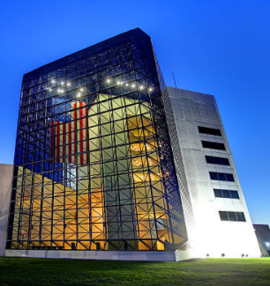
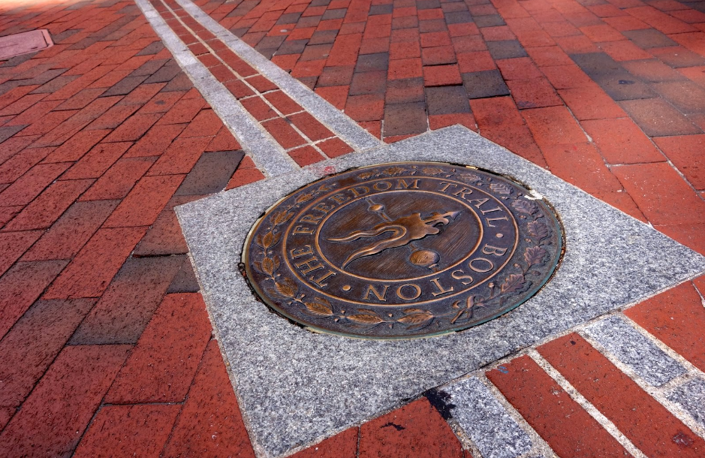
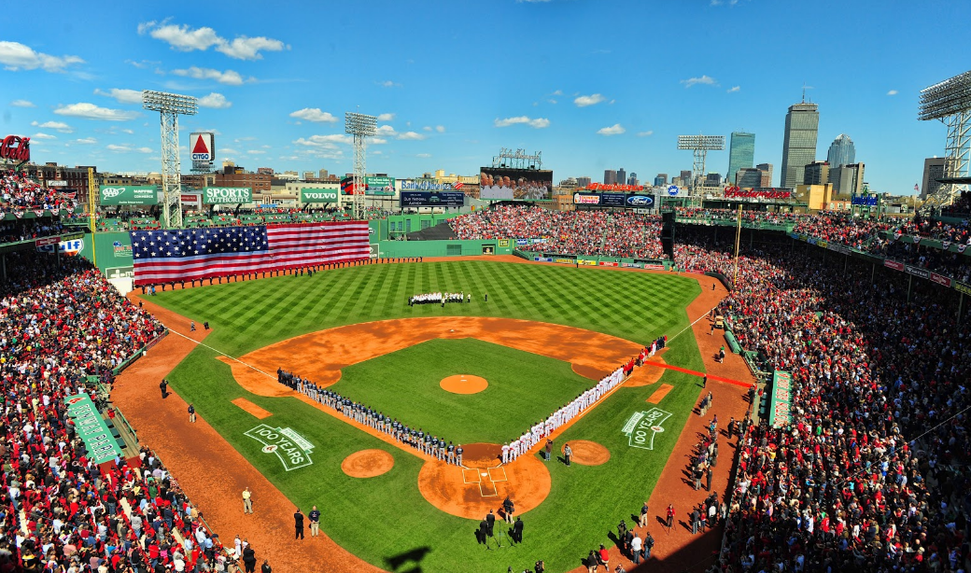
Guided tour of JFK Presidential Library and Museum
Fenway park tour and Boston Red Sox game
Walking tour of The Freedom Trail
See Old North Church, Old State House, Faneuil Hall, and more
MIT Interactive group tour

Slide 8
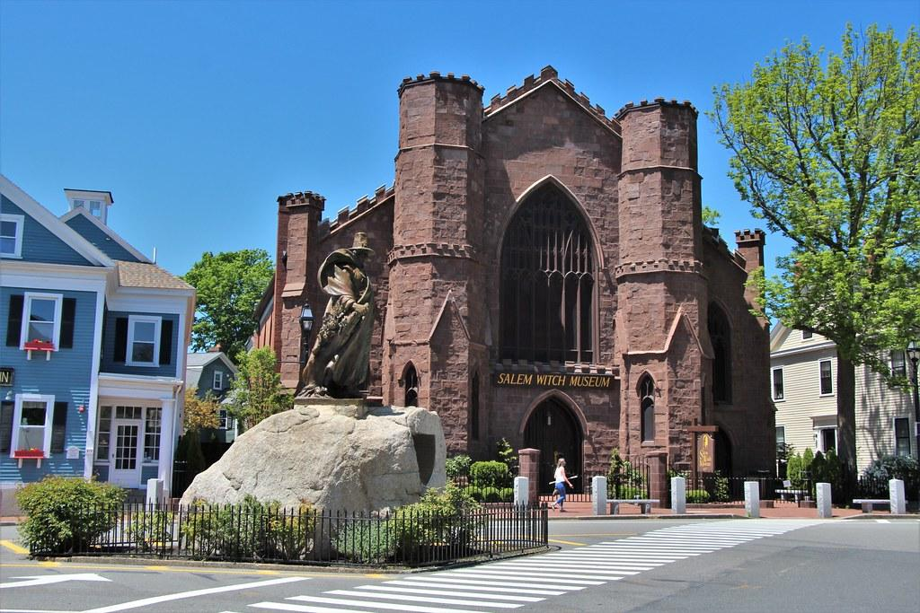
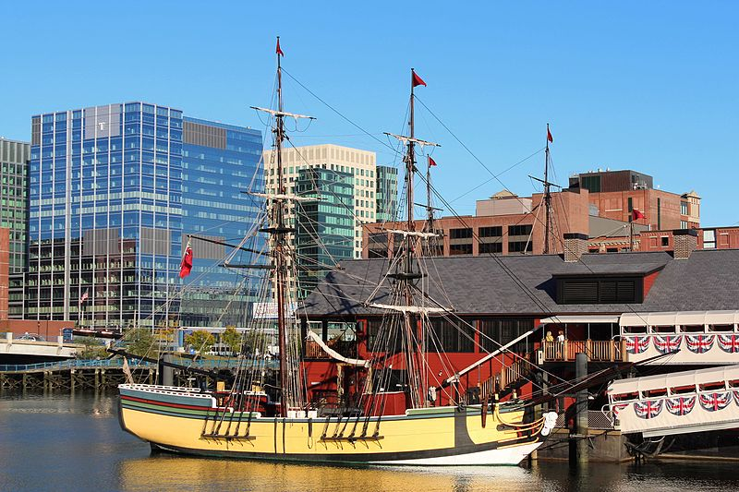
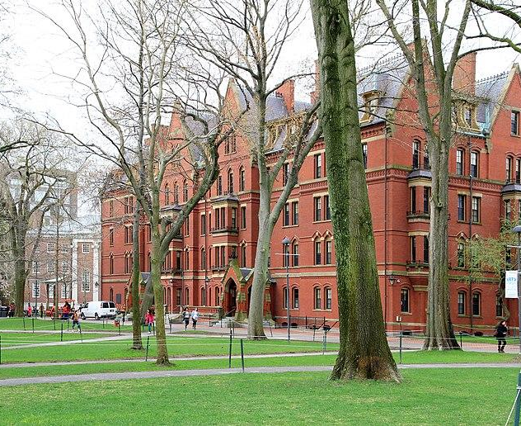
Tour Harvard University
Take a Boston Duck Tour to see Boston's famous sites from the water
Visit the Boston Tea Party Ships & Museum
Team building activities at Boda Borg
Guided tour of Salem

Slide 9
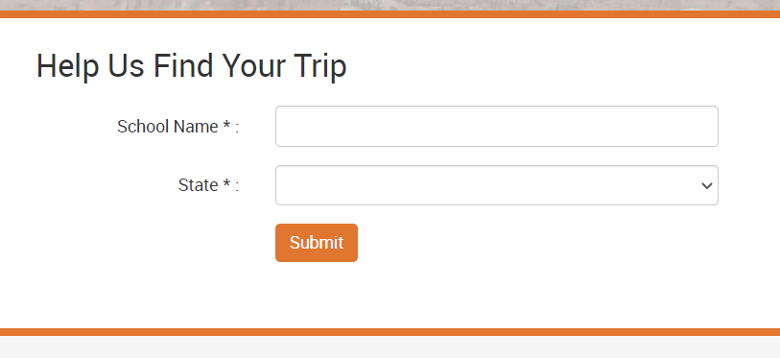
How to Register
Visit www.grandclassroom.com and search for your trip by entering your school name and state.
$1919 per student
$199 deposit due at registration
Optional payment plans available at registration.
Trip Protection Options
Travel Refund Program (included in cost)
Travel Refund Program Plus: $189
(24 hours - includes cancellations due to COVID 19)
See Terms and Conditions for more information.

Slide 10
FAQs
What does the trip cost include? It is an all-inclusive price that covers airfare, motor coach, tour guides, lodging, all meals while on tour, activity admissions, medical/dental coverage, and trip planning.
How much spending money should I bring? We recommend about $50-$100 for snacks and souvenirs.
What is the rooming situation? Students stay 3-4 to a room. Teachers will assign rooms.
What forms do I need to fill out? You will be sent a medical form and a behavior contract through the Grand Classroom trip page closer to travel. This is where you will note any dietary restrictions or allergies. Any additional forms required will be included in your parent pack that will be sent prior to departure.

Slide 11
Questions?
Contact your Grand Classroom representative,
Emily Forrest
Email: emily@grandclassroom.com
Phone: 434-975-2629

Slide 12
See you in historic Boston!

