Slide 1
Sunset Elementary School
Washington, D.C. Adventure March 28th - 31st 2023

Slide 2
Who is...

Slide 3
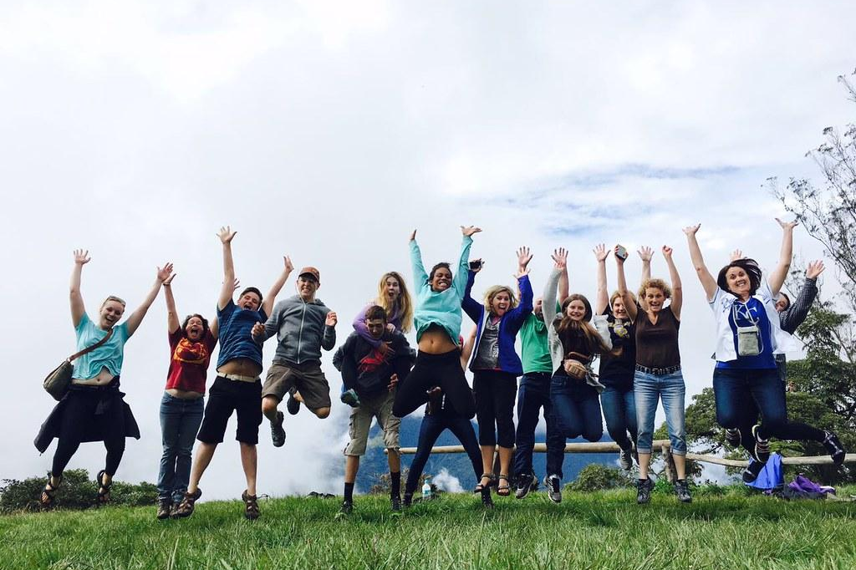
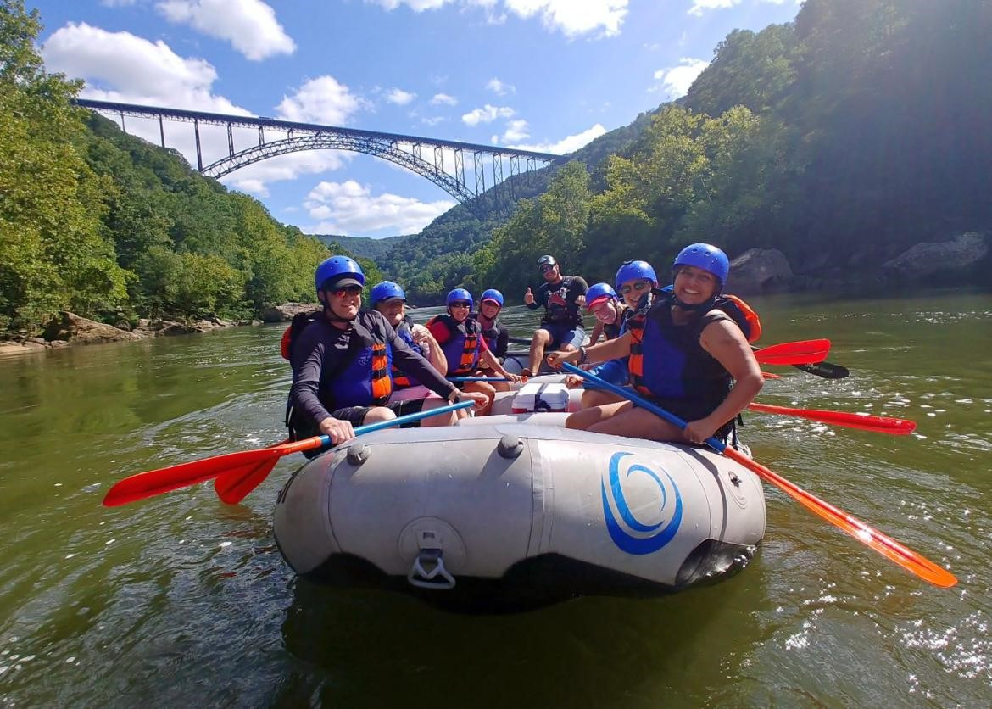
Grand Classroom is a student travel company that specializes in taking young people on educational trips around the world.
Grand Classroom began with trips to our National Parks in 2002 and has grown to include historic U.S. cities and international destinations. Our programs span from Washington, D.C. and New York to the Grand Canyon, Yellowstone, Florida, Puerto Rico, the Pacific Northwest, Galapagos, Belize, Iceland, Costa Rica, and more!

Slide 4
Safety is our main concern...
24 Hour Grand Classroom guides
24 hour emergency contact number
On-call telemedicine
Medical and dental insurance while on tour
Liability insurance
Security at hotels

Slide 5
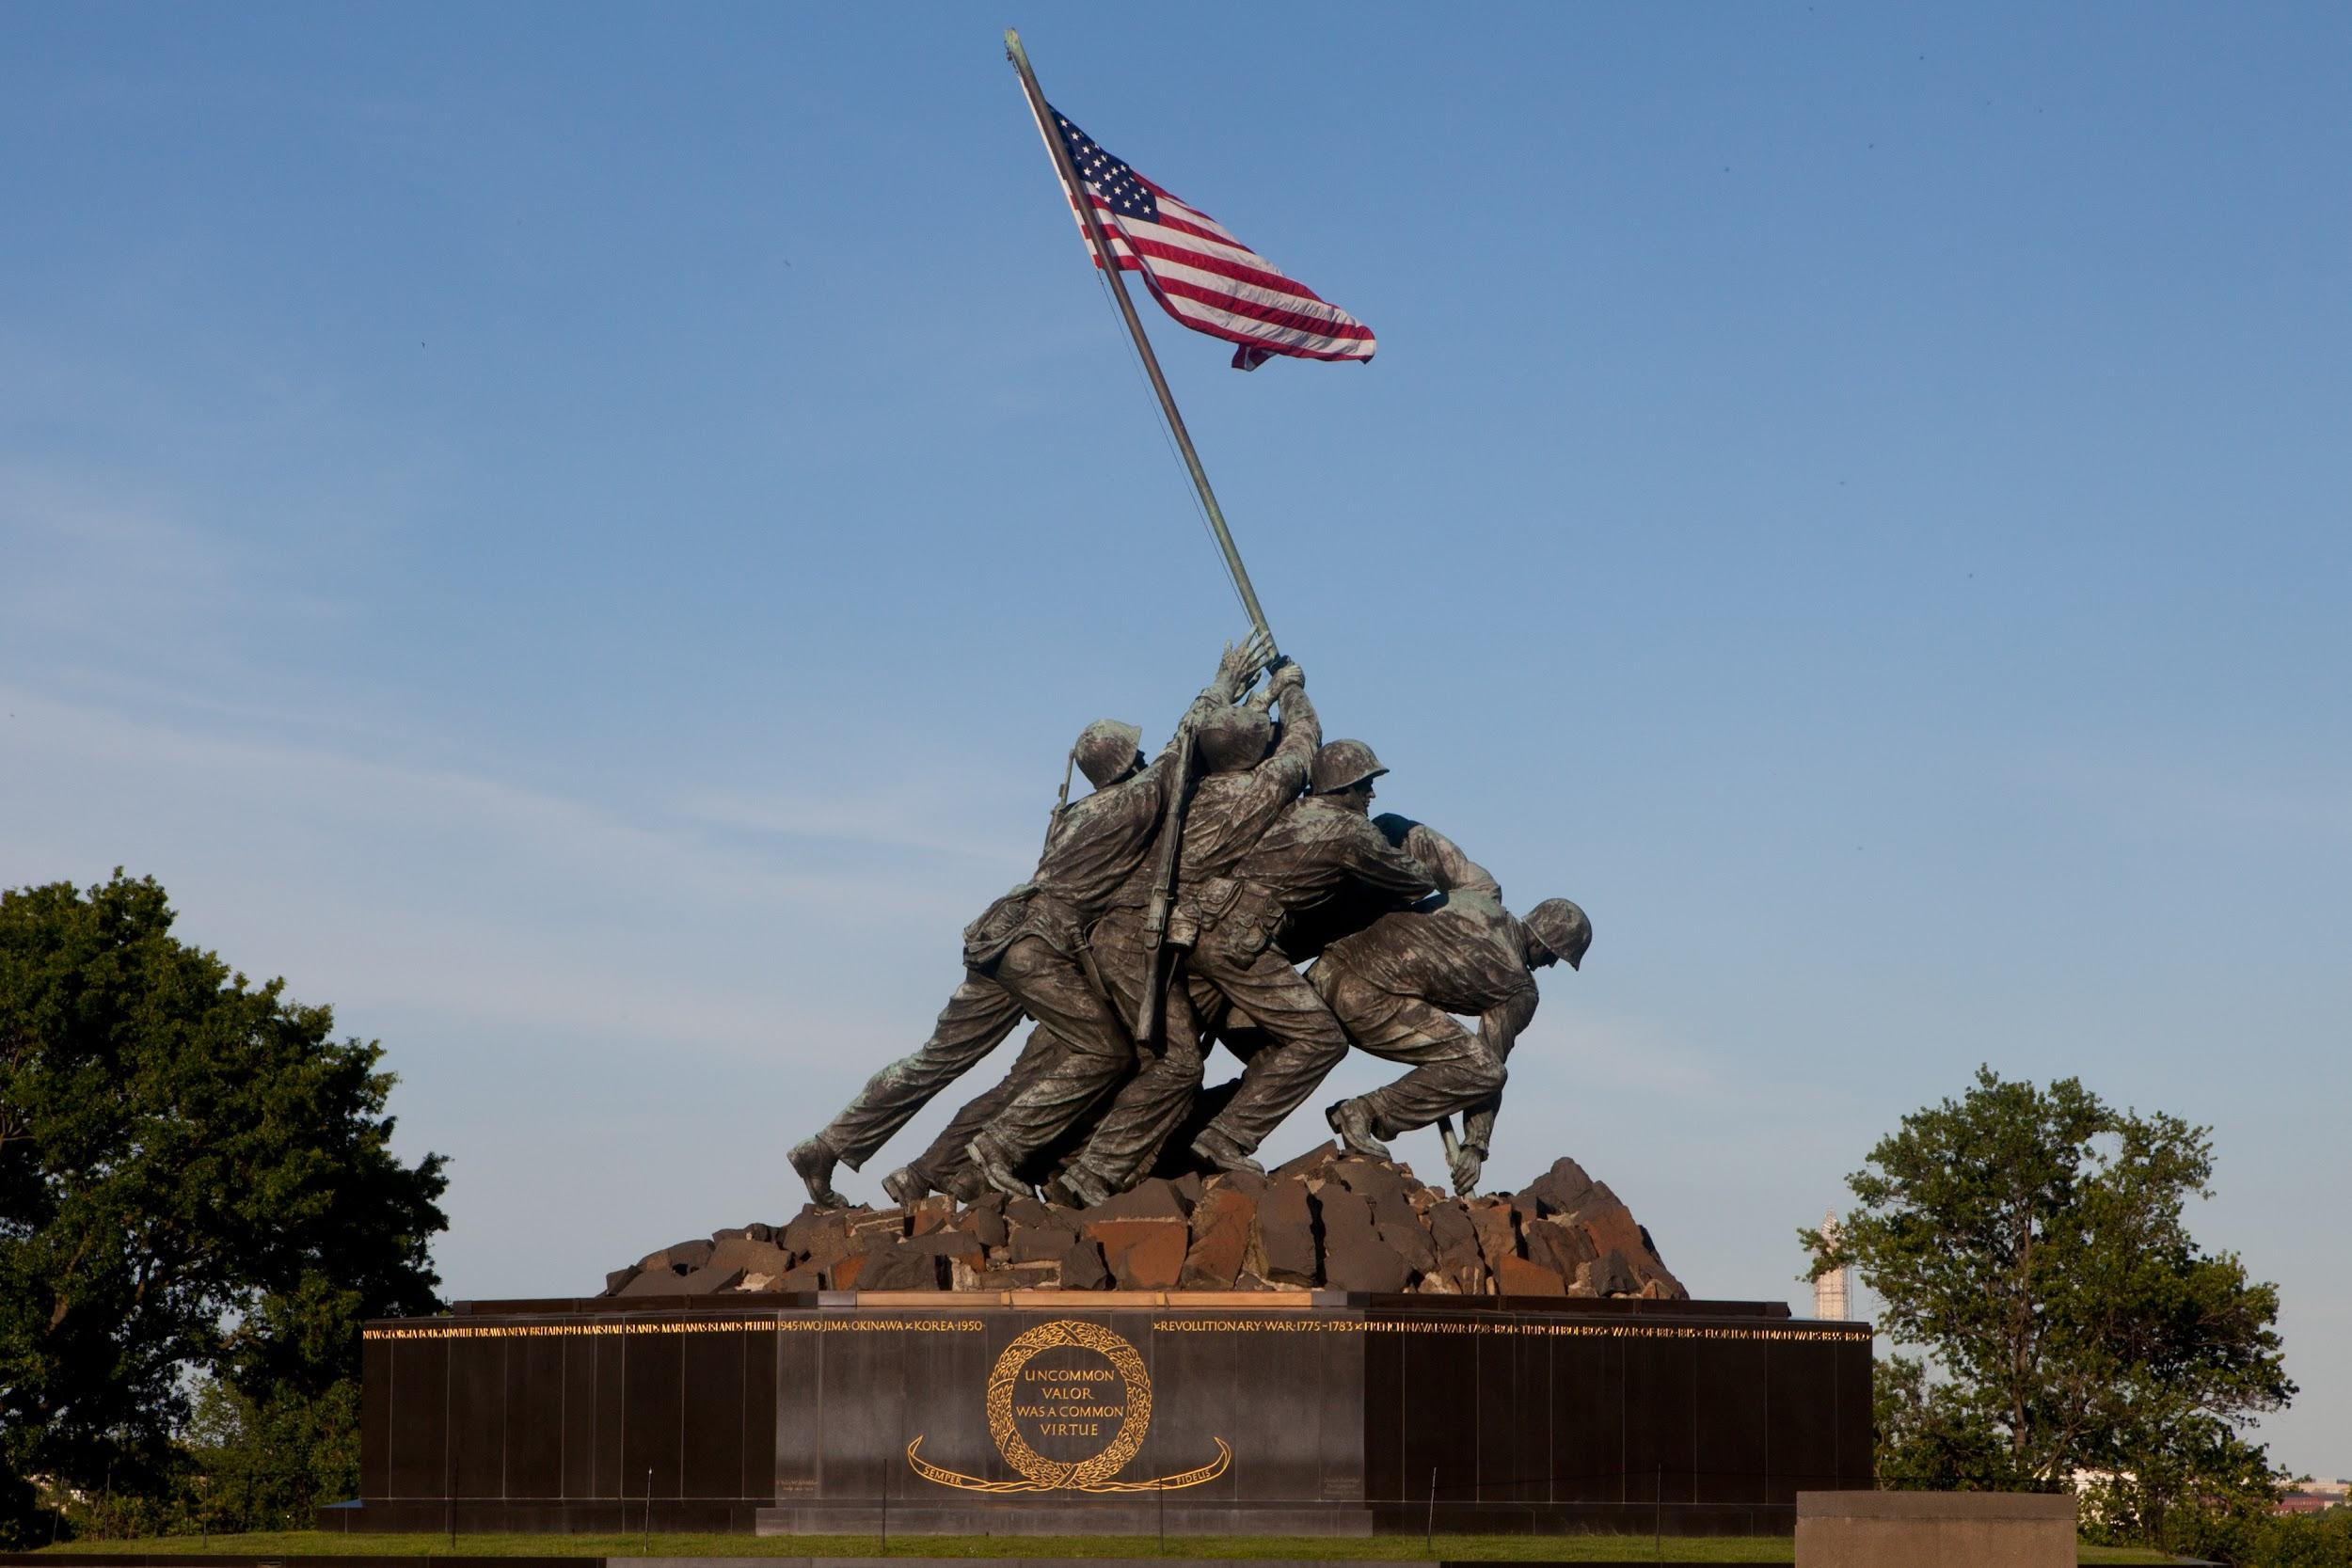
Student Health on Tour
Parents will notify Grand Classroom of any medical conditions or dietary concerns prior to travel.
Grand Classroom will work directly with our vendors to accommodate dietary restrictions.
Students and teachers hold on to and administer any student medication while on tour.

Slide 6
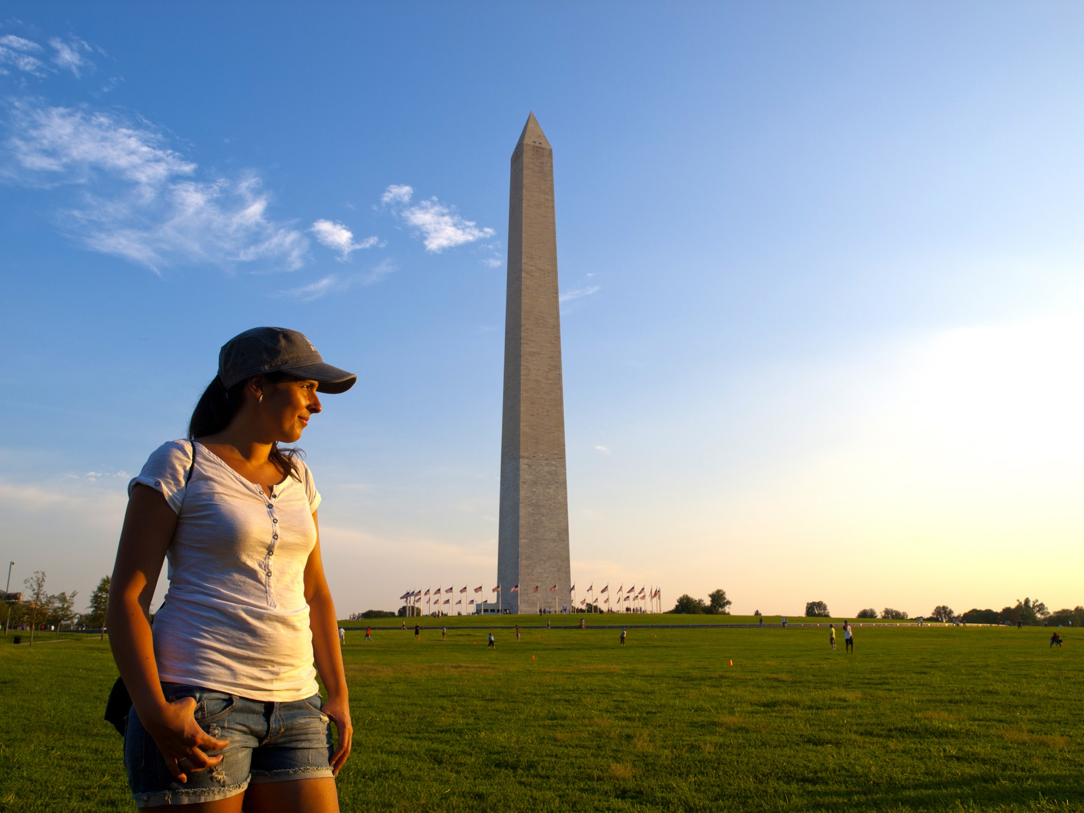
Benefits of Student Travel
Builds confidence
Encourages leadership
Harvests friendships
Provides education outside the classroom
Teaches team building
Instills independence
Provides adventure
Bestows stewardship towards the environment

Slide 7
Trip Highlights

Slide 8
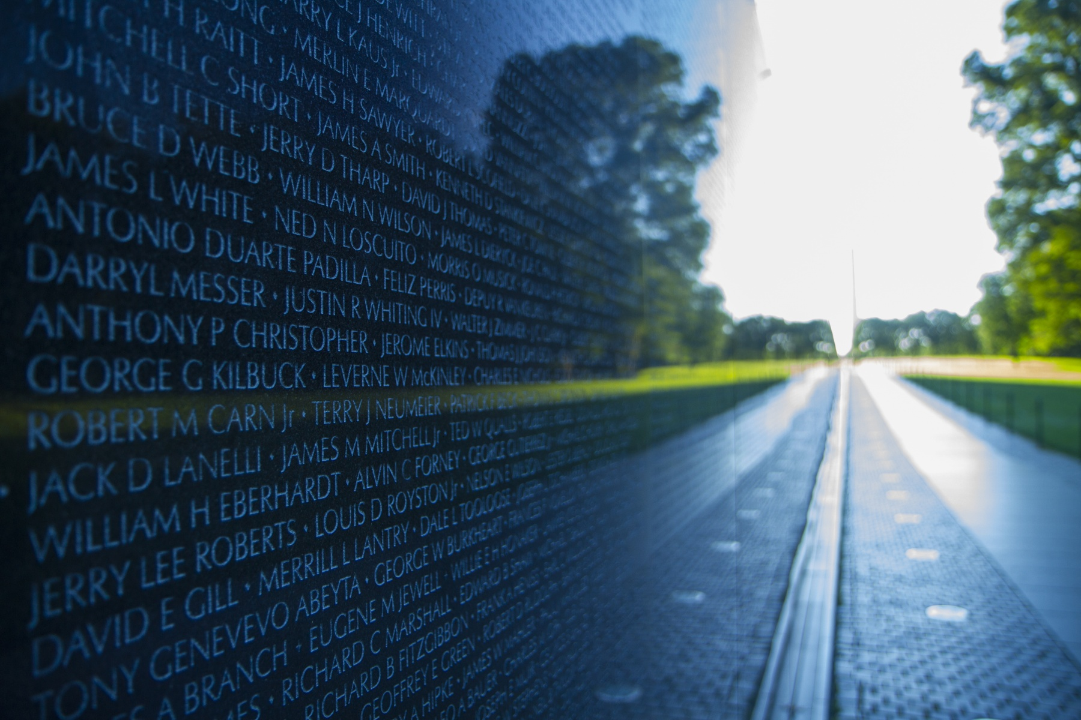
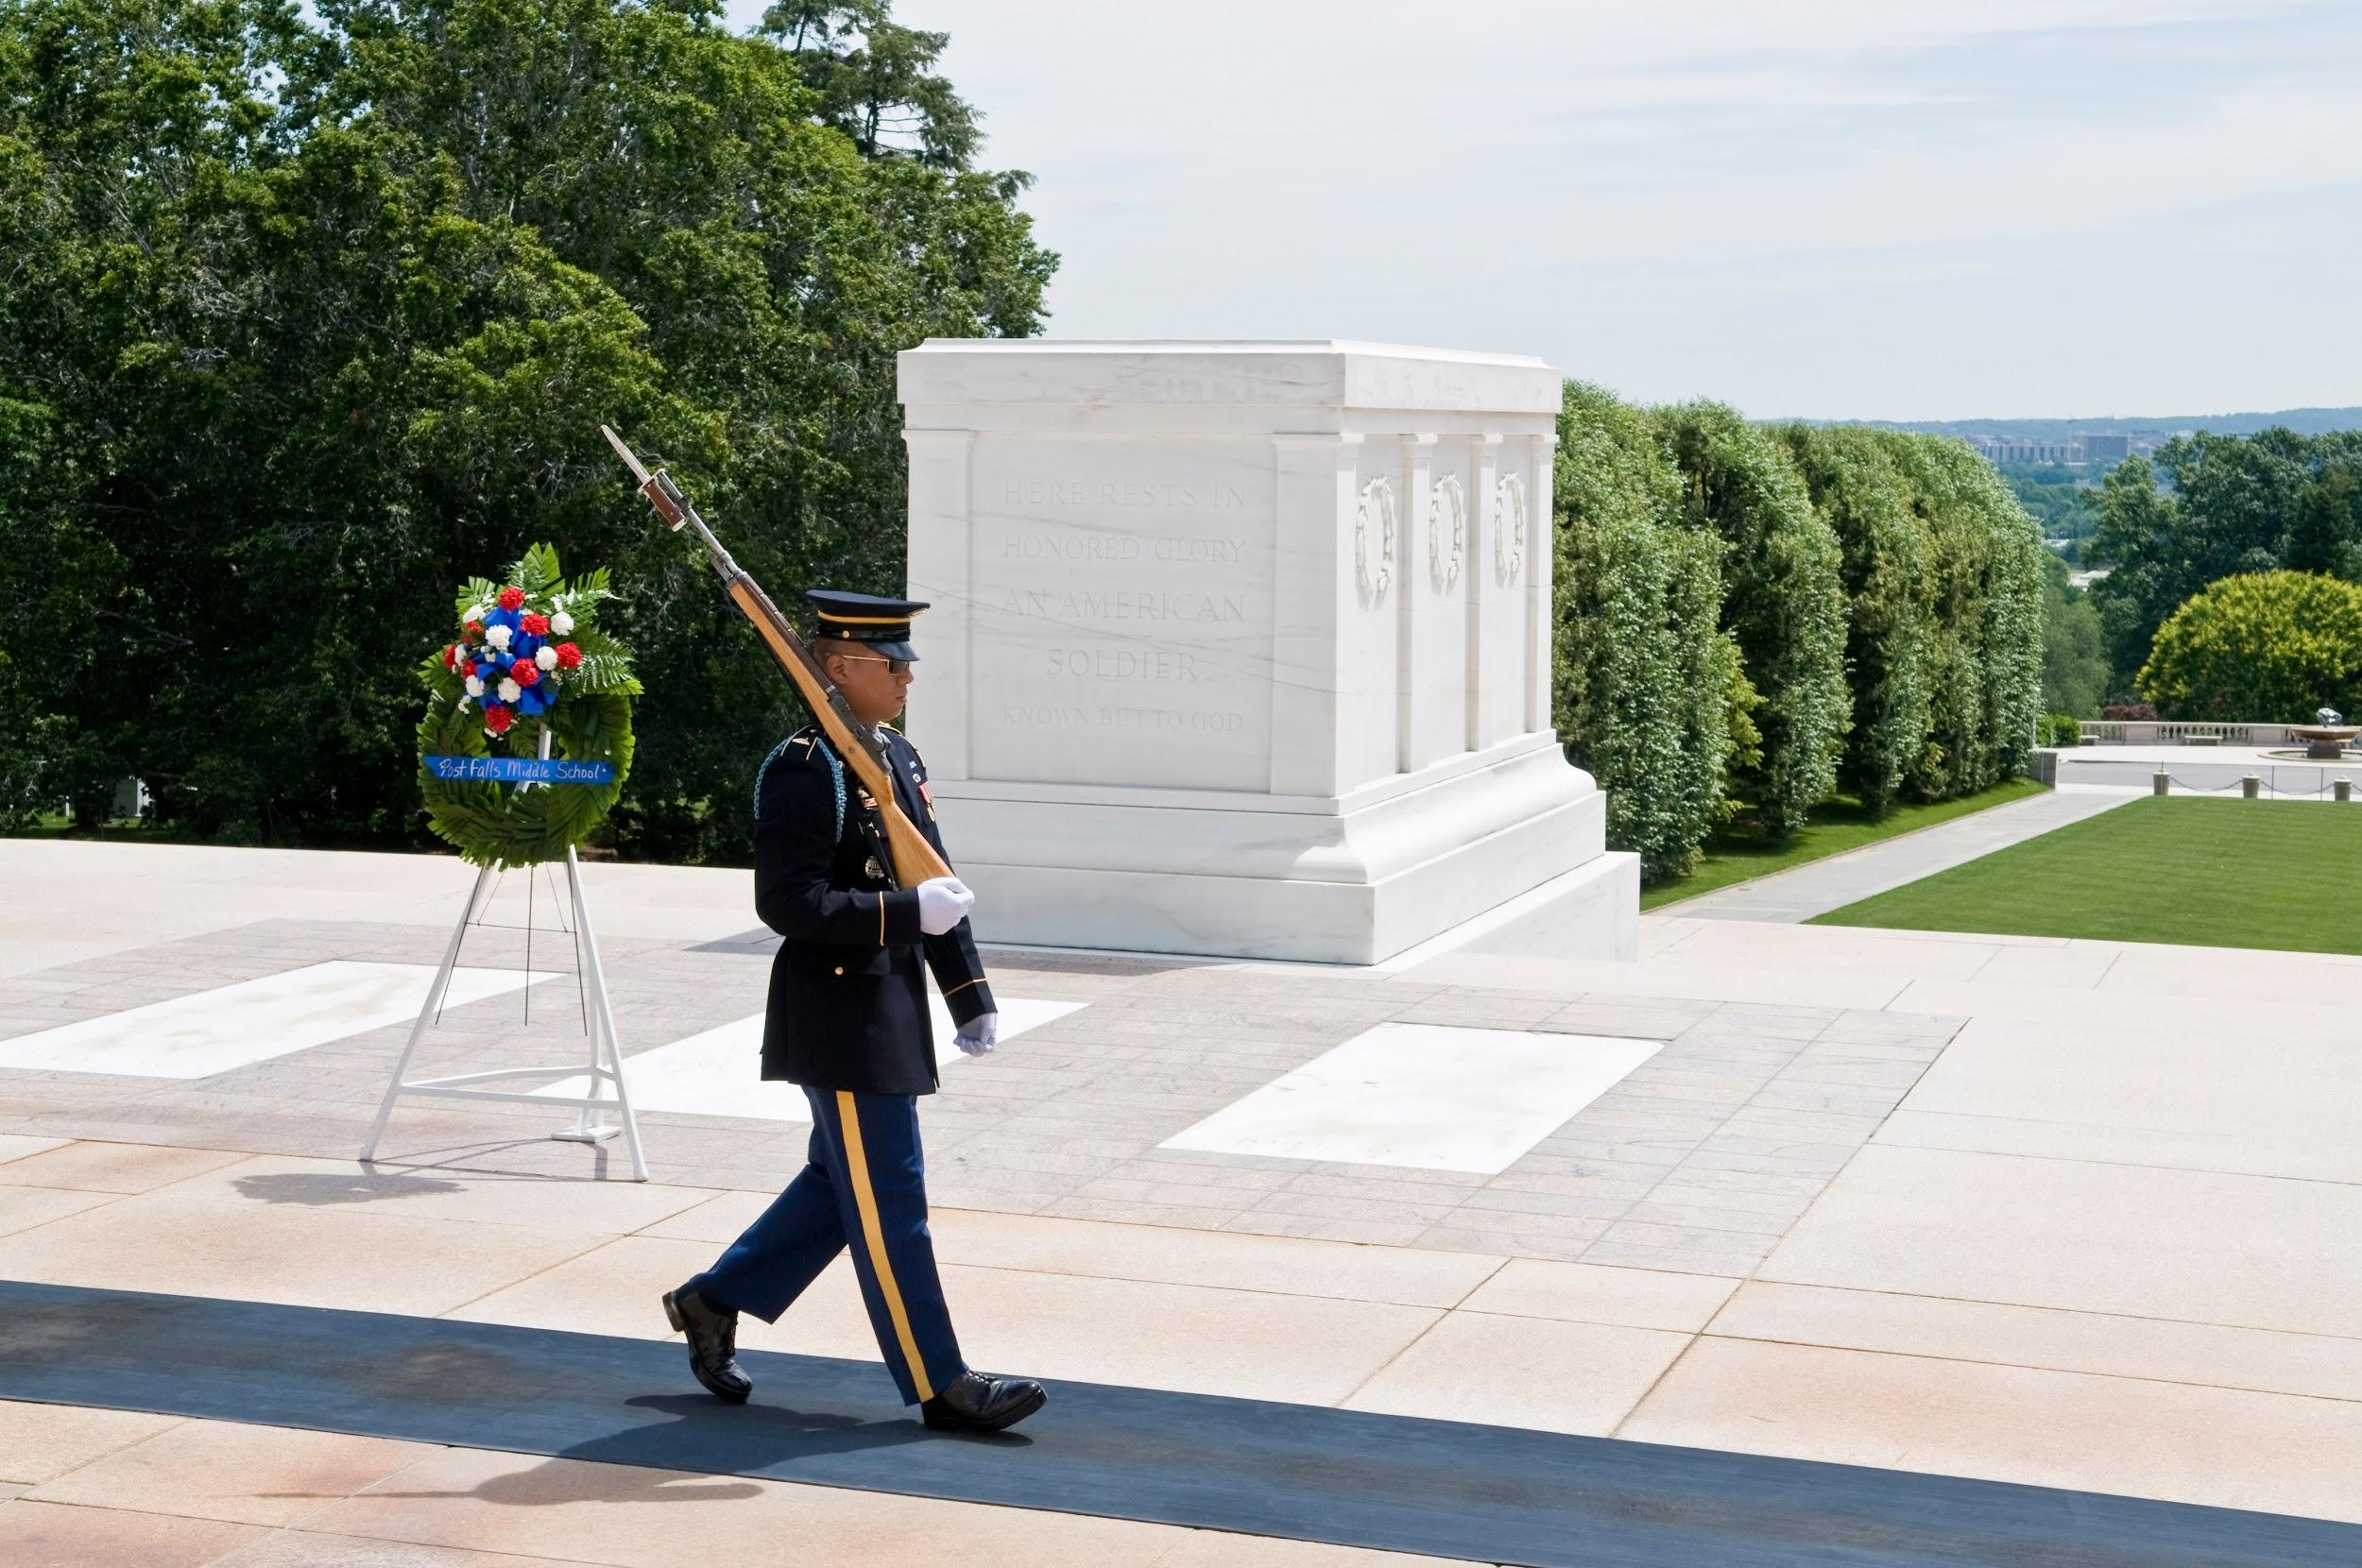
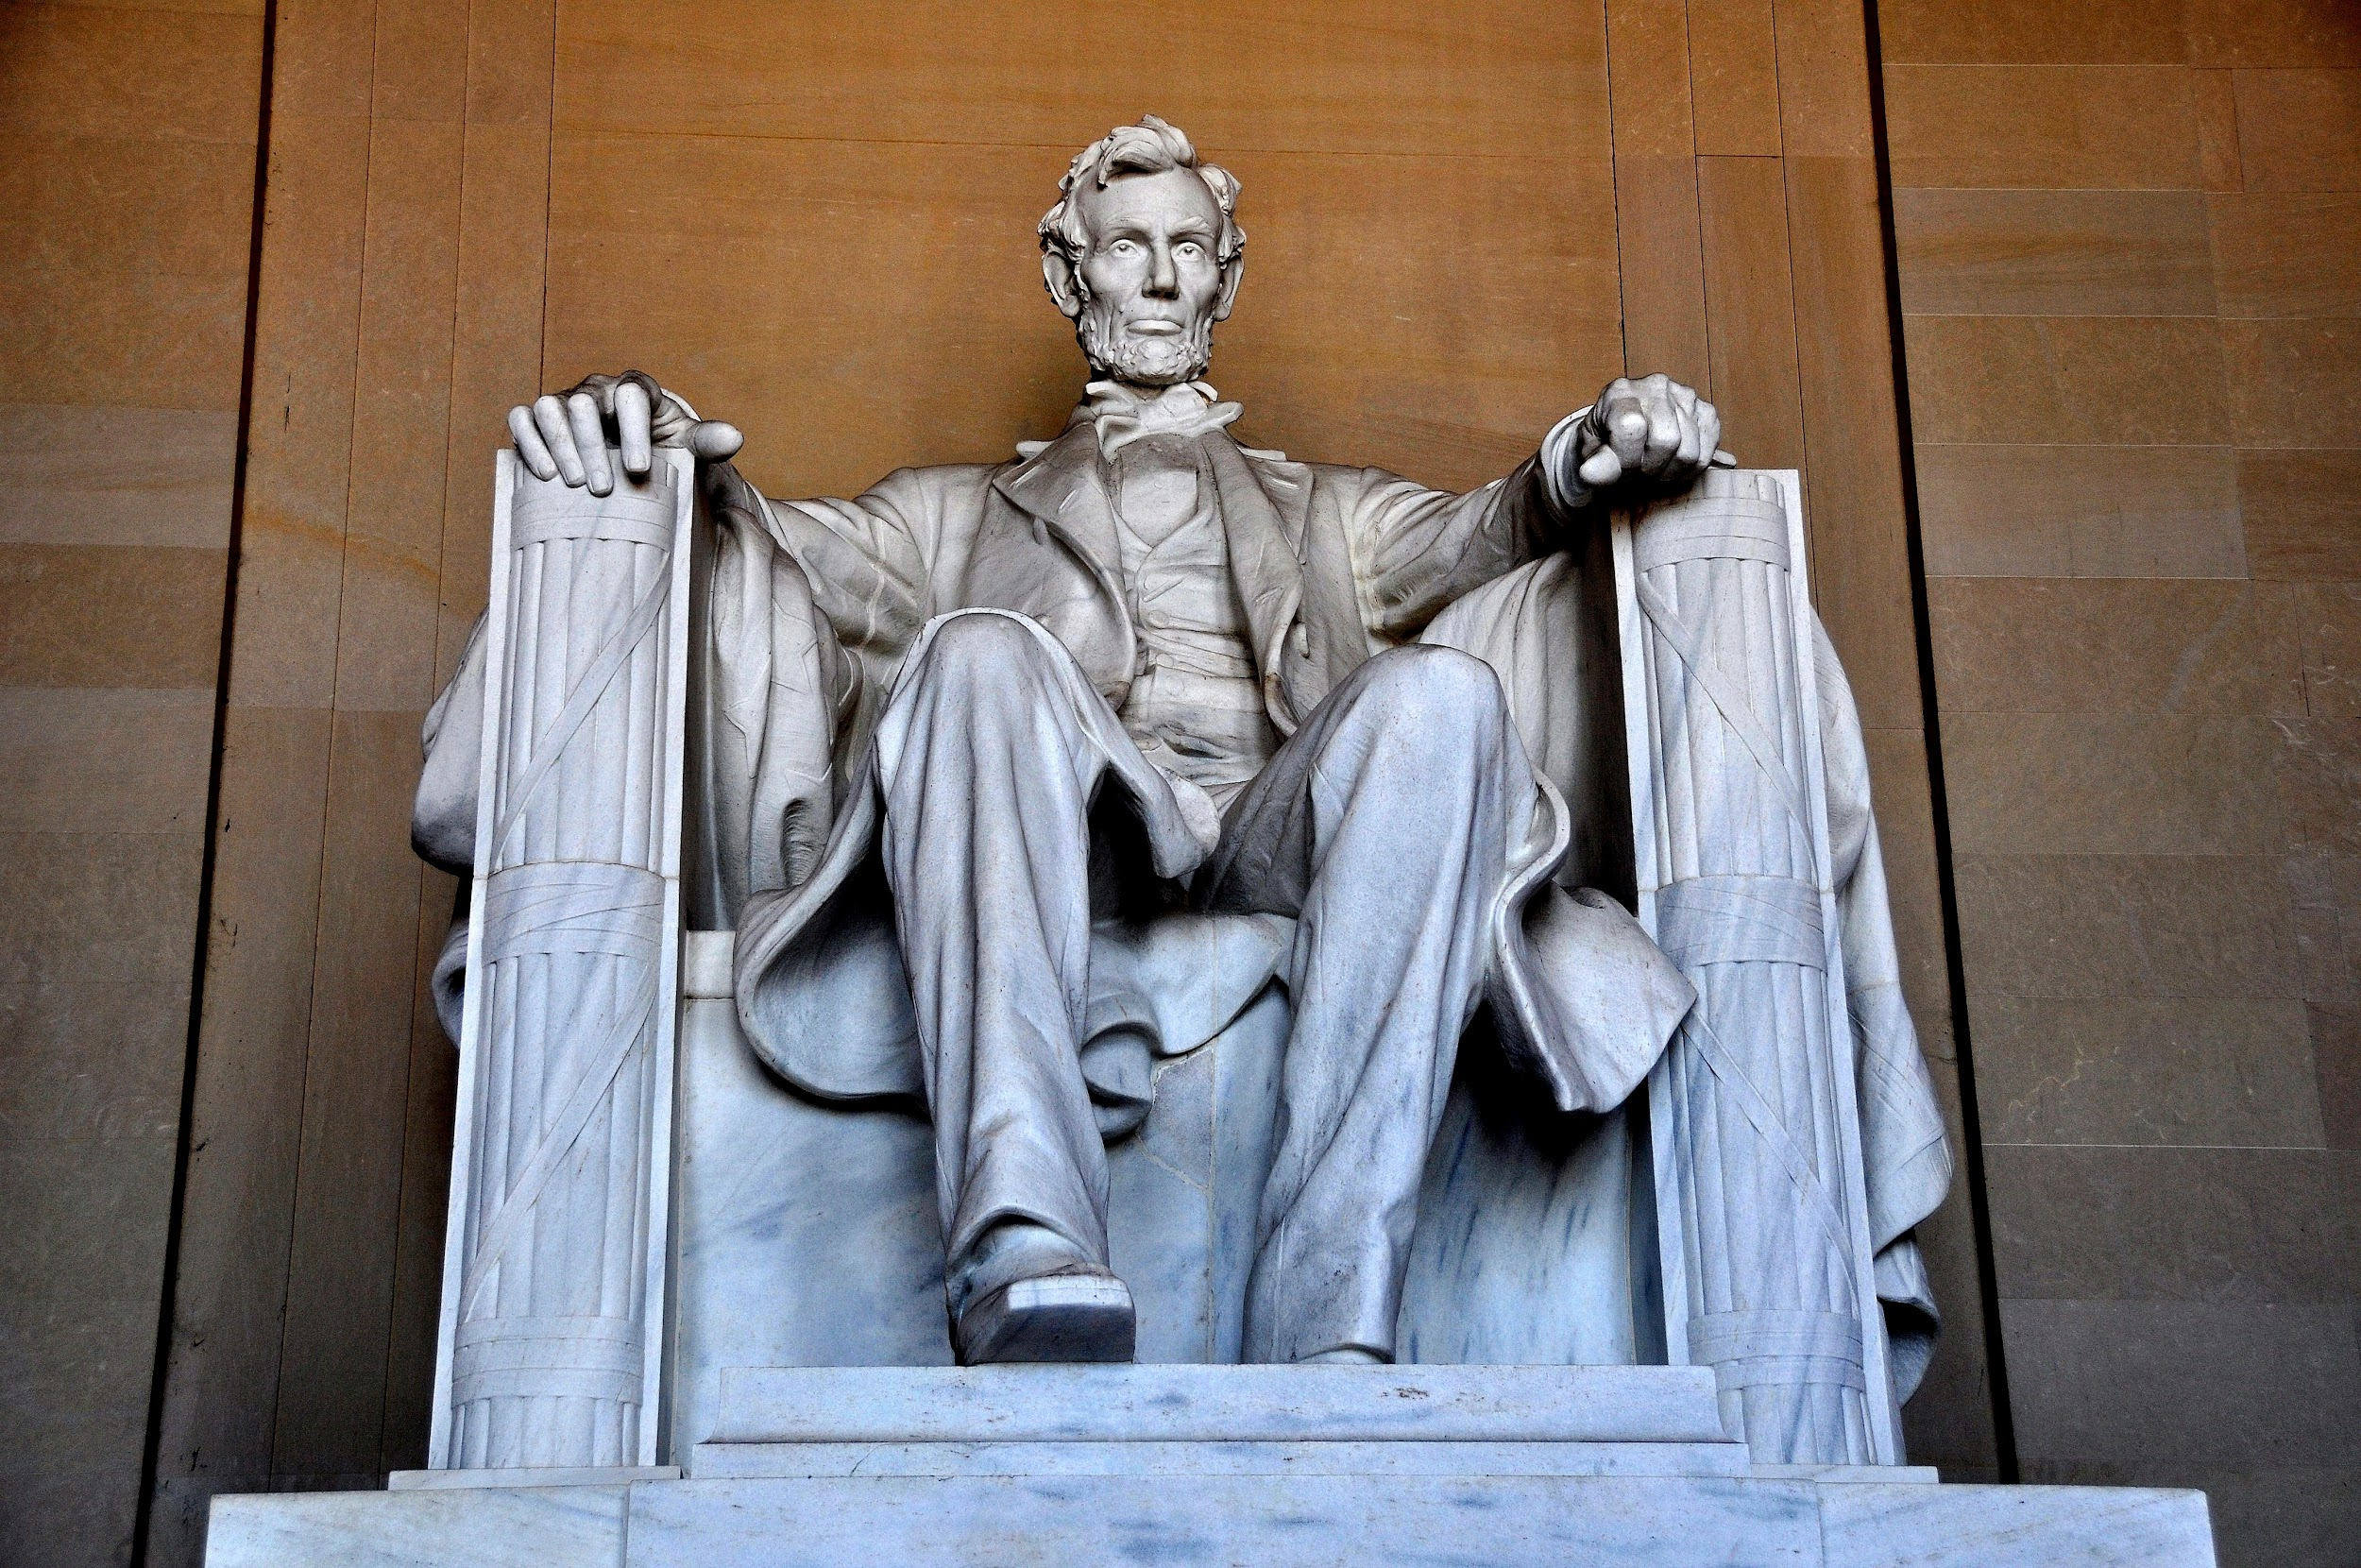
Enjoy an evening tour of the many monuments and memorials of Washington, D.C.
Visit Arlington National Cemetery and see the Changing of the Guard at the Tomb of the Unknown Soldier
Iwo Jima Memorial

Slide 9
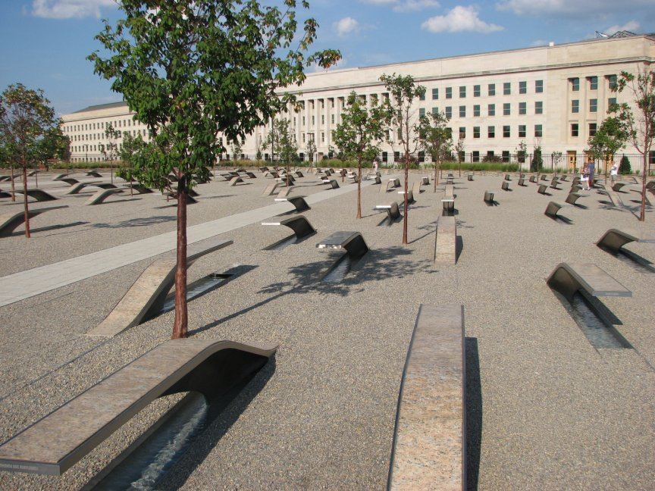
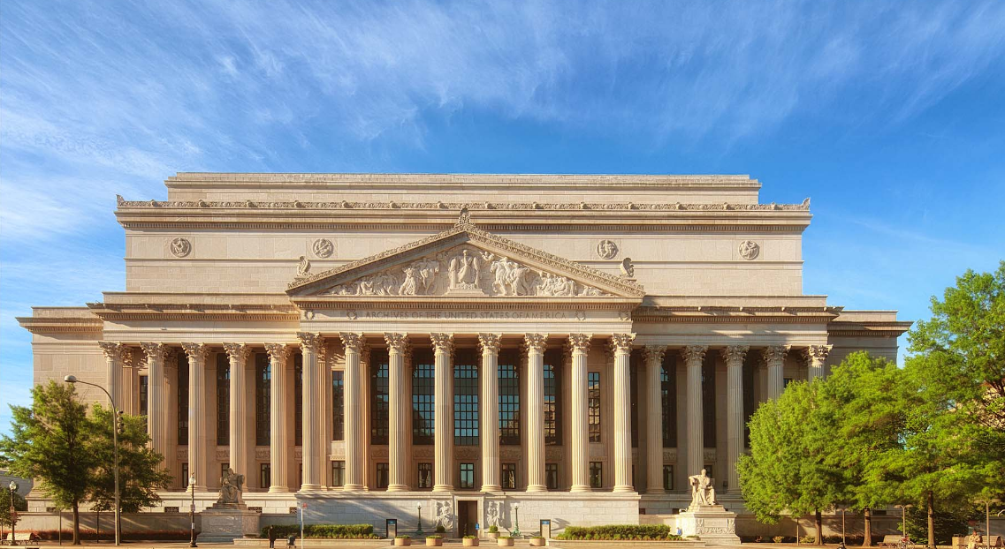
Pentagon 9/11 Memorial
Air Force Memorial
National Archives

Slide 10
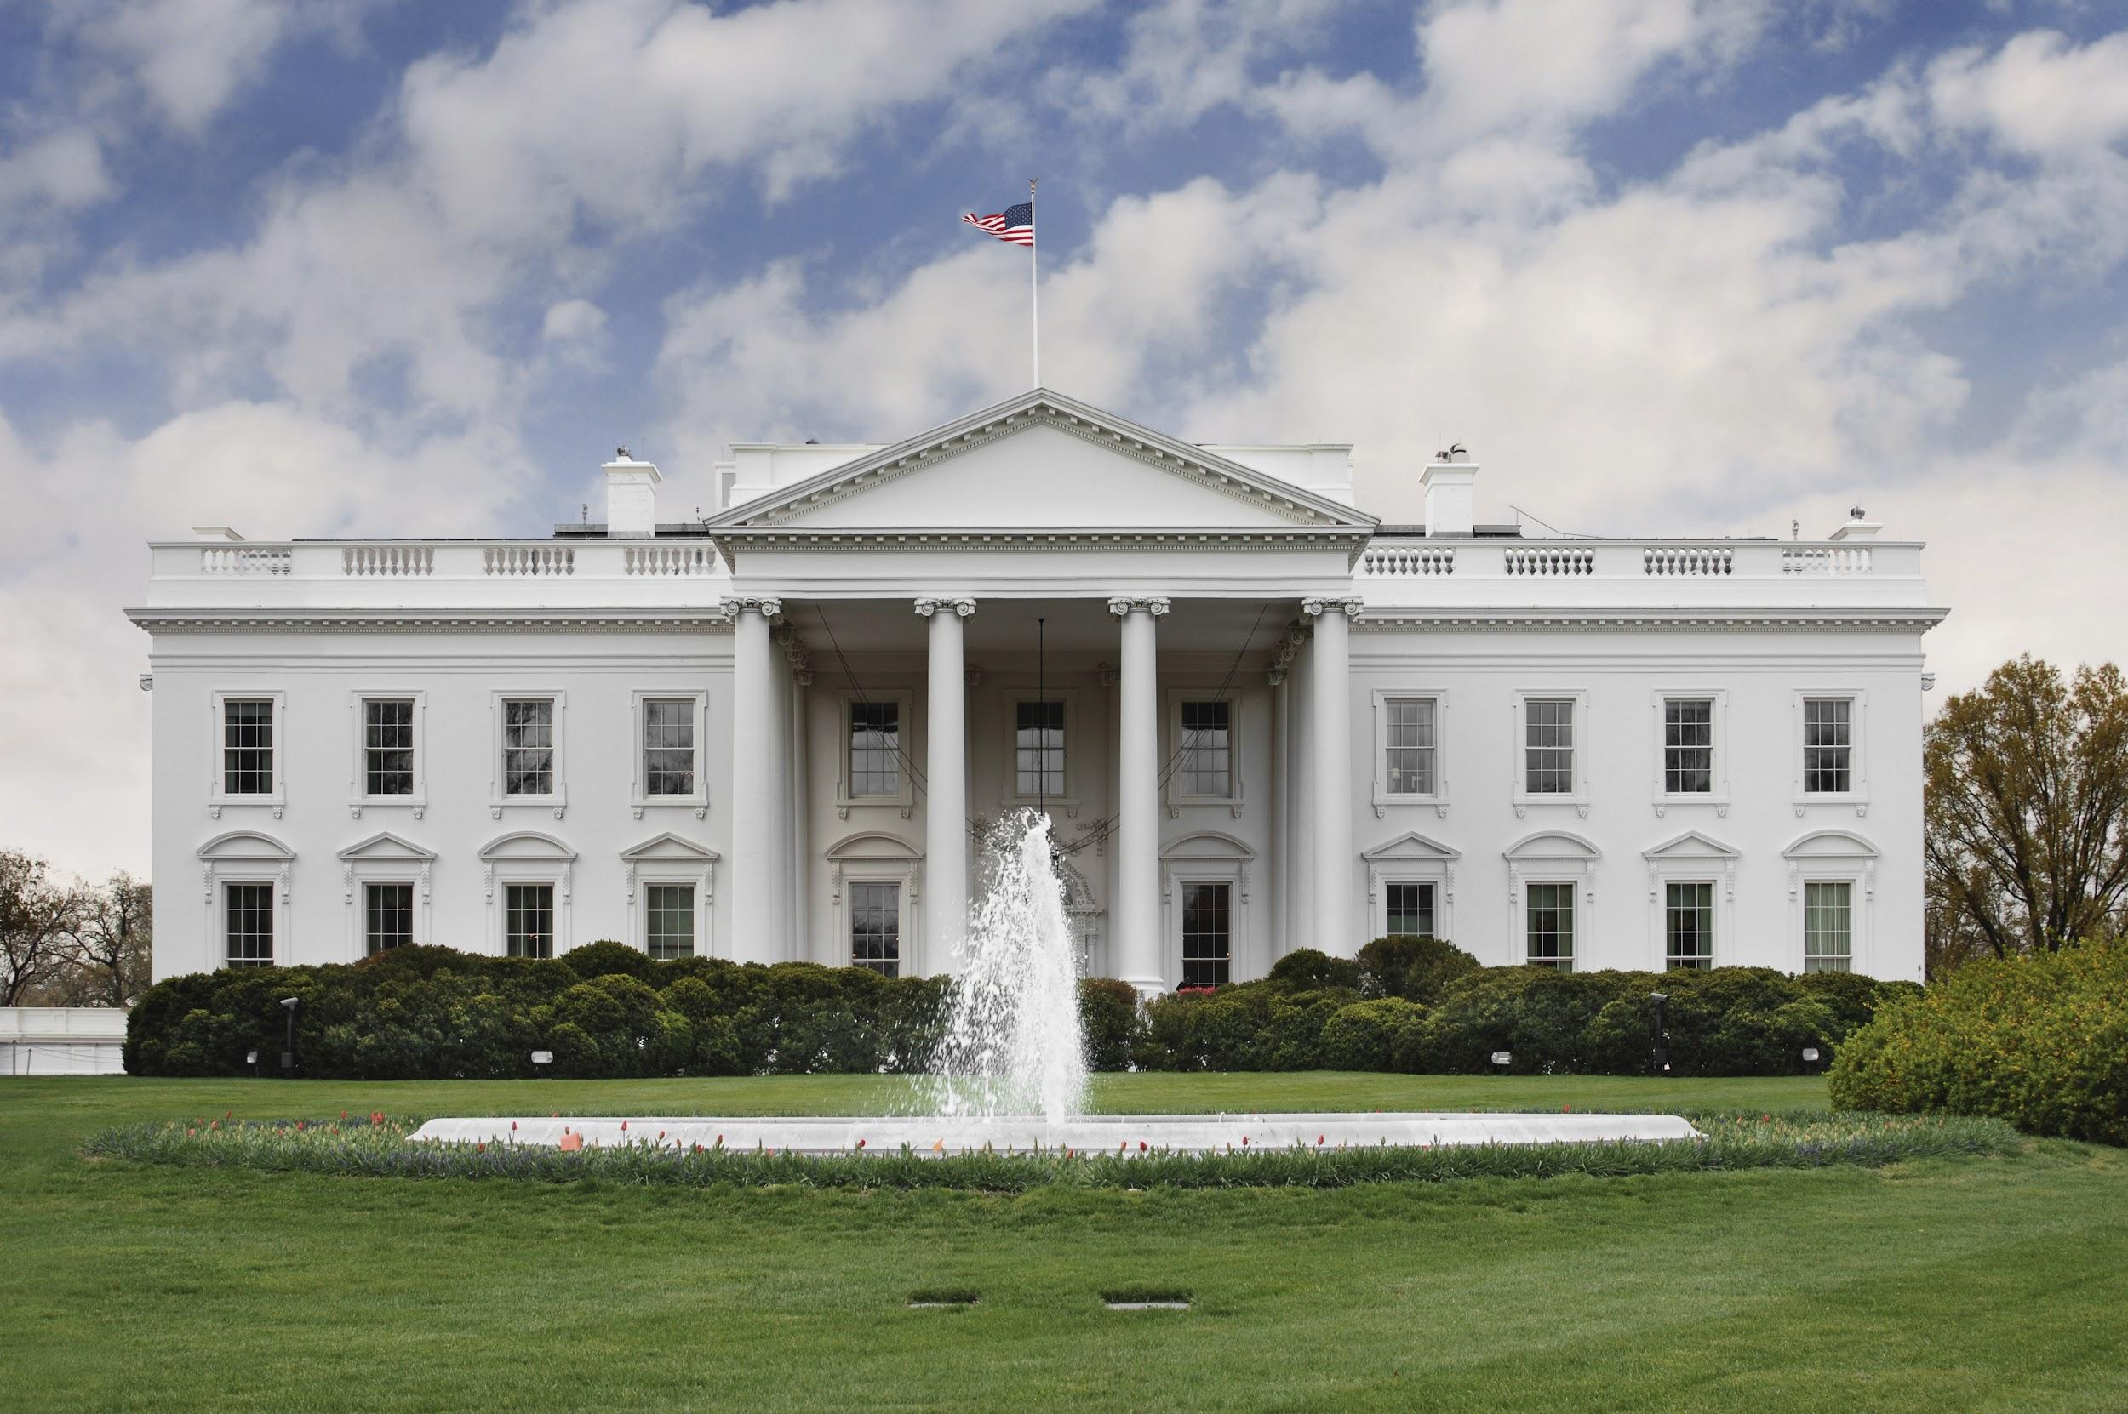
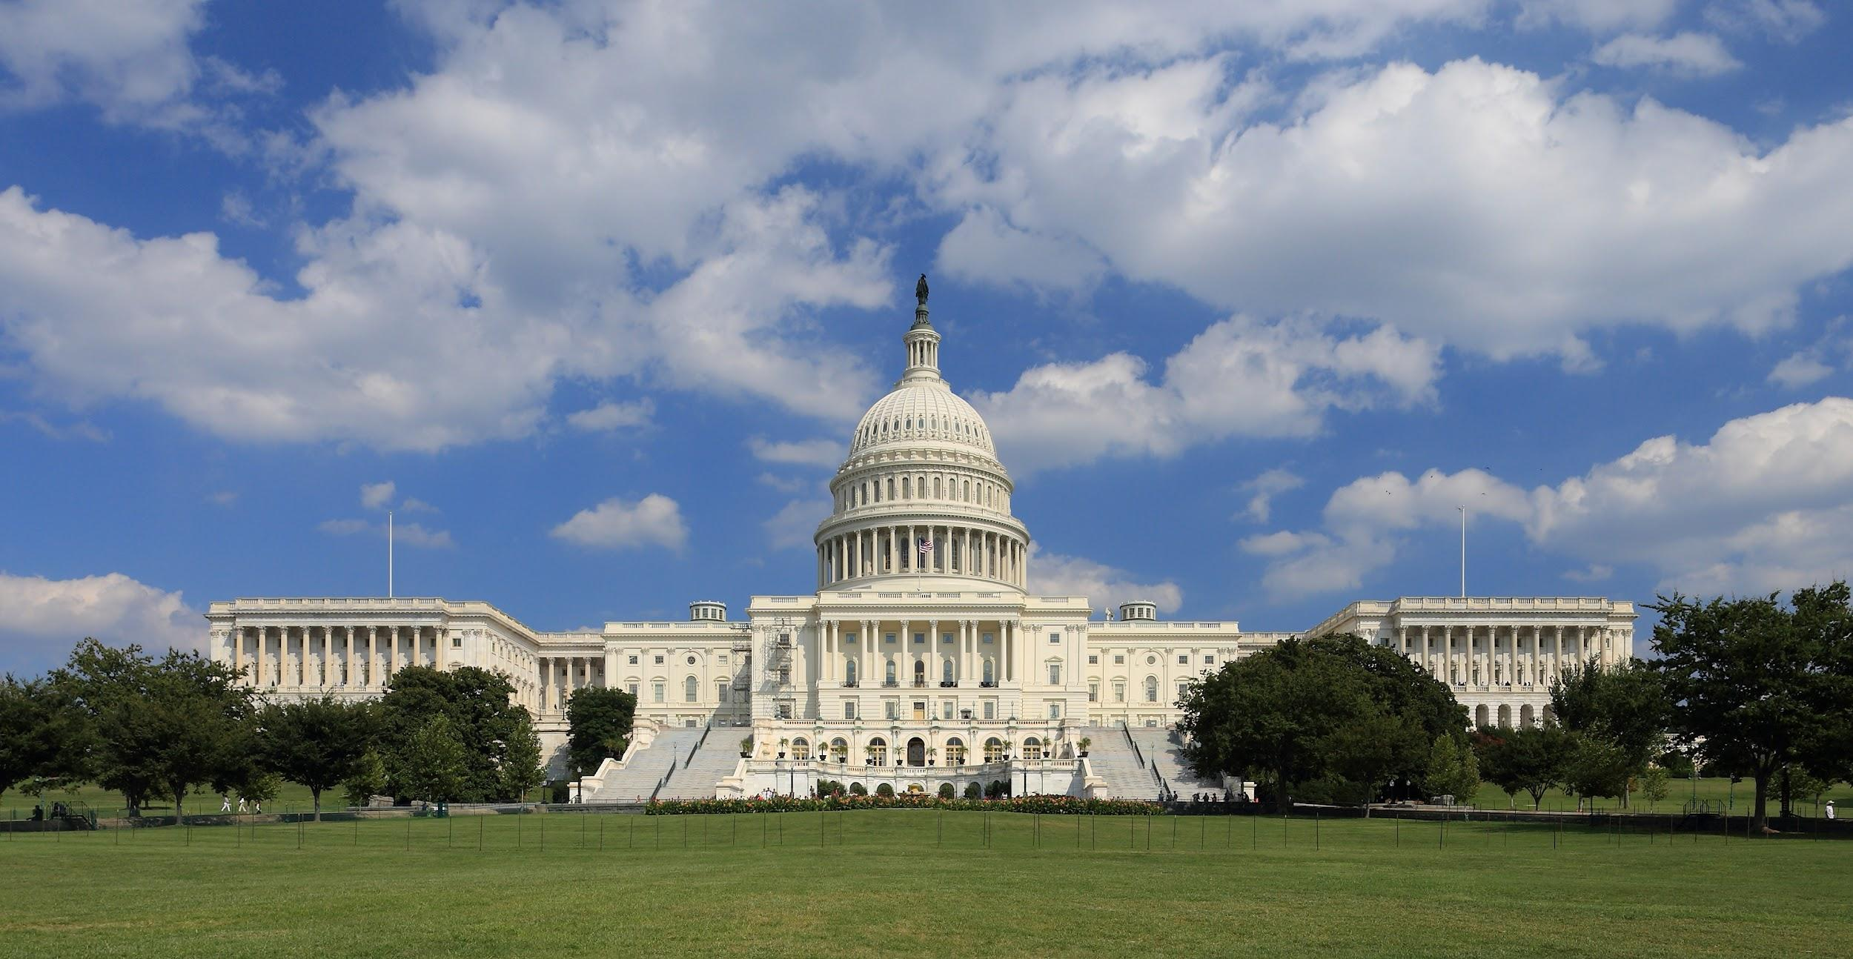
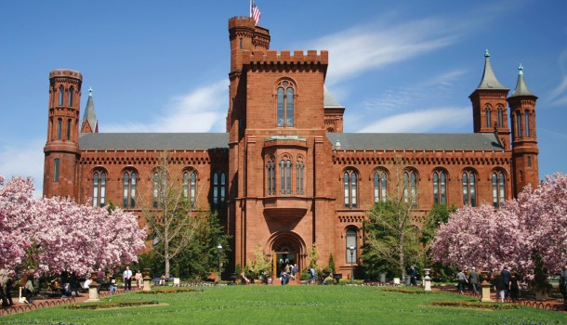
White House (picture stop)
Smithsonian Museums including the American History Museum, Natural History Museum, and the National Museum of the American Indian
Walking tour of the U.S. Capitol
Ford’s Theatre

Slide 11
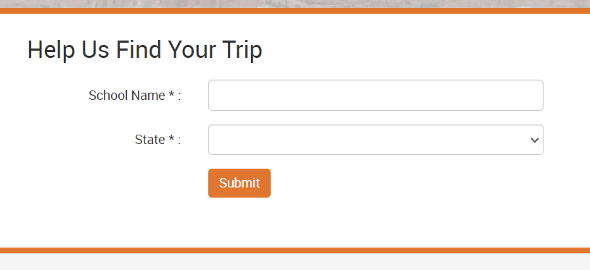
How to Register
Visit www.grandclassroom.com and search for your trip by entering your school name and state.
$733 per student/$933 per adult
$99 deposit due at registration
Optional payment plans available at registration.
Travel Refund Program Plus: $139
Travel Refund Program: $66
See Terms and Conditions for more information.

Slide 12
FAQs
What does the trip cost include? It is an all-inclusive price that covers airfare, motor coach, tour guide, lodging, all meals while on tour, activity admissions, medical/dental coverage, and trip planning.
How much spending money should I bring? We recommend about $50-$100 for snacks, souvenirs and an optional tip for your Grand Classroom guide.
What is the rooming situation? Students stay 3-4 to a room. Teachers will assign rooms.
What forms do I need to fill out? You will be sent a medical form and a behavior contract through the Grand Classroom trip page closer to travel. This is where you will note any dietary restrictions or allergies.

Slide 13
Questions?
Contact your Grand Classroom representative,
Iris Keogh
Email: iris@grandclassroom.com
Phone: 434-975-2629

Slide 14
See you in Washington, D.C.!

